Slide 1
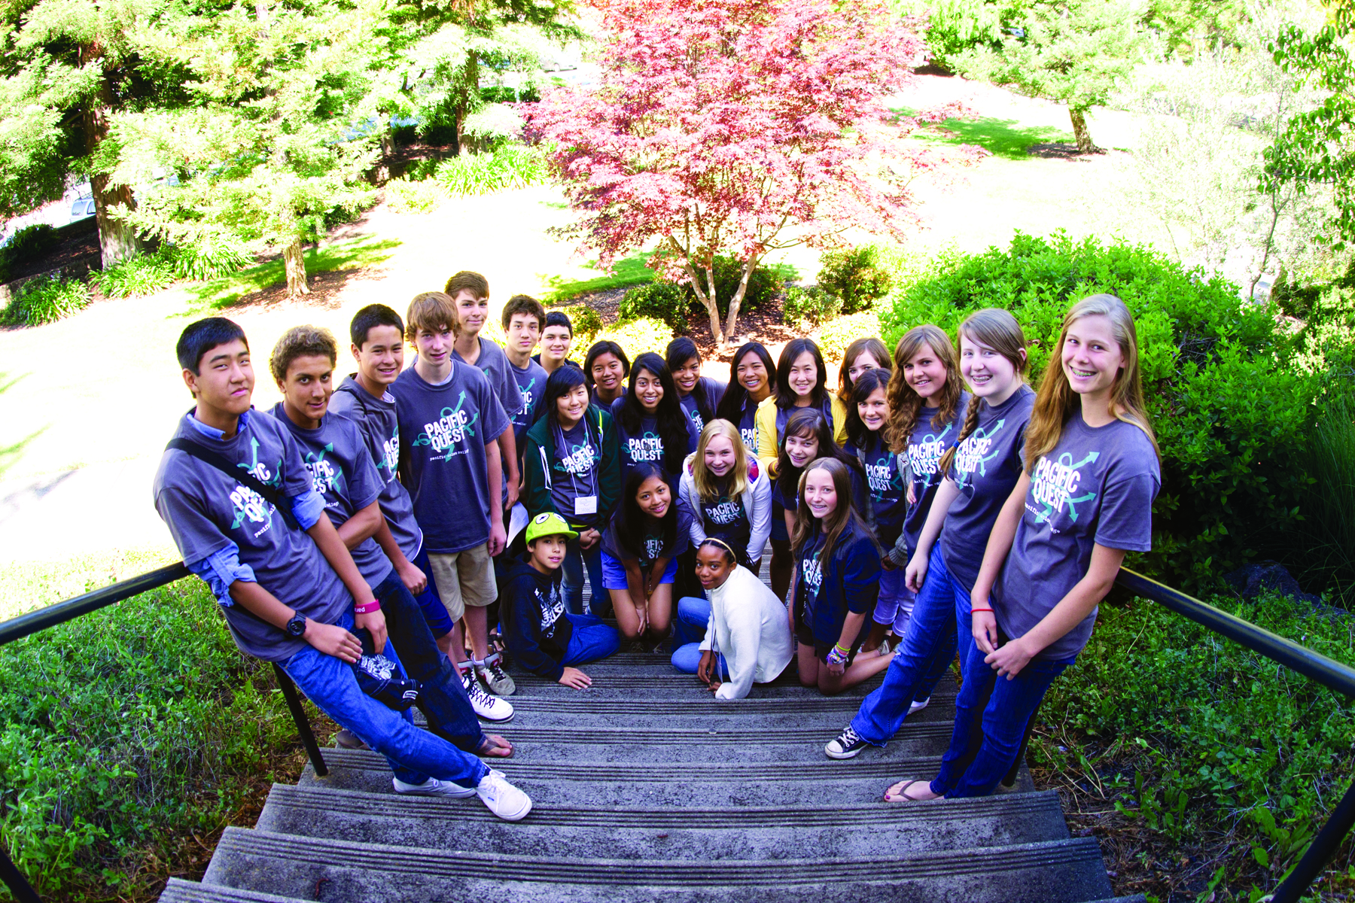
PacificQuest 2011

Slide 2
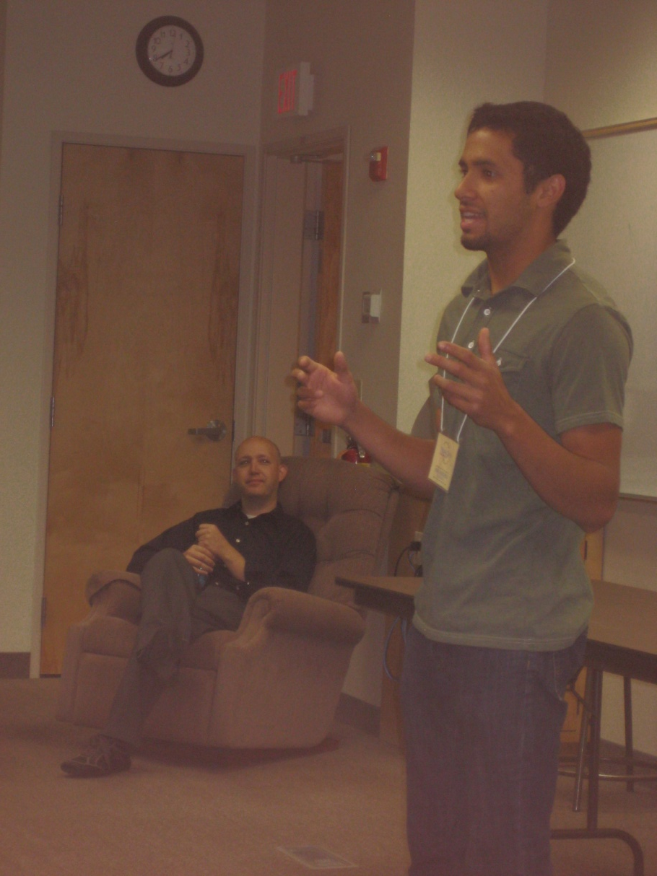
Worship
Pastor Mark

Slide 3
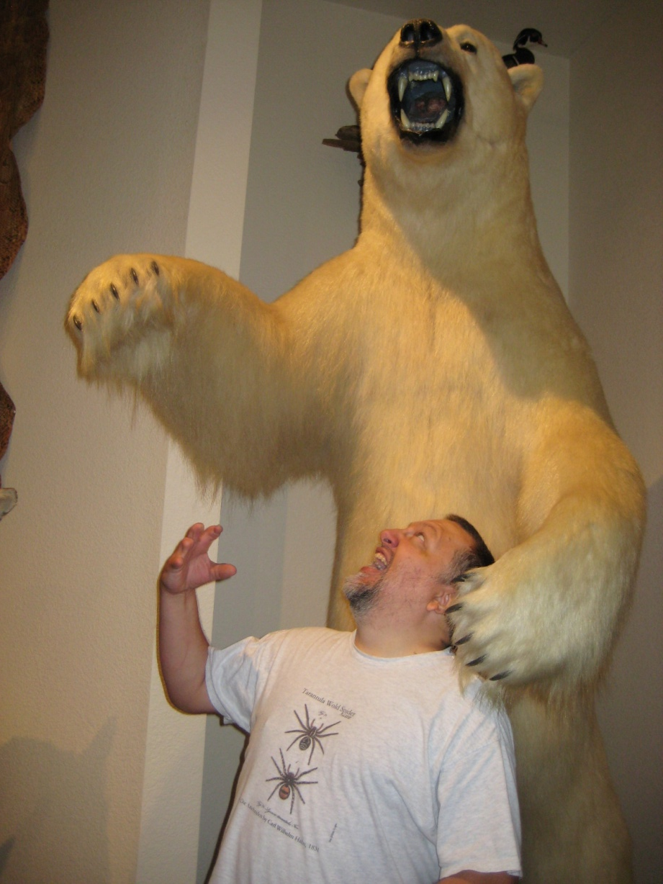
Biology
Dr. Bryan Ness

Slide 4
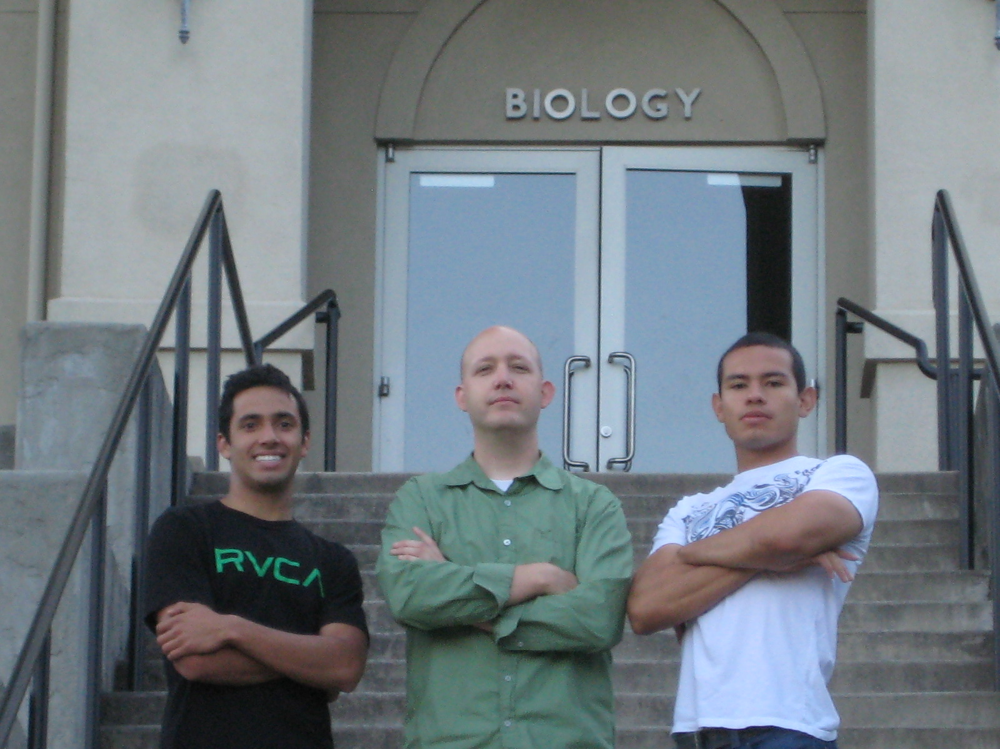

Slide 5
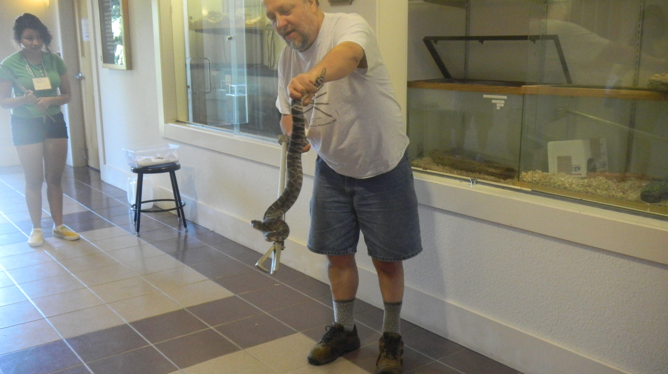

Slide 6
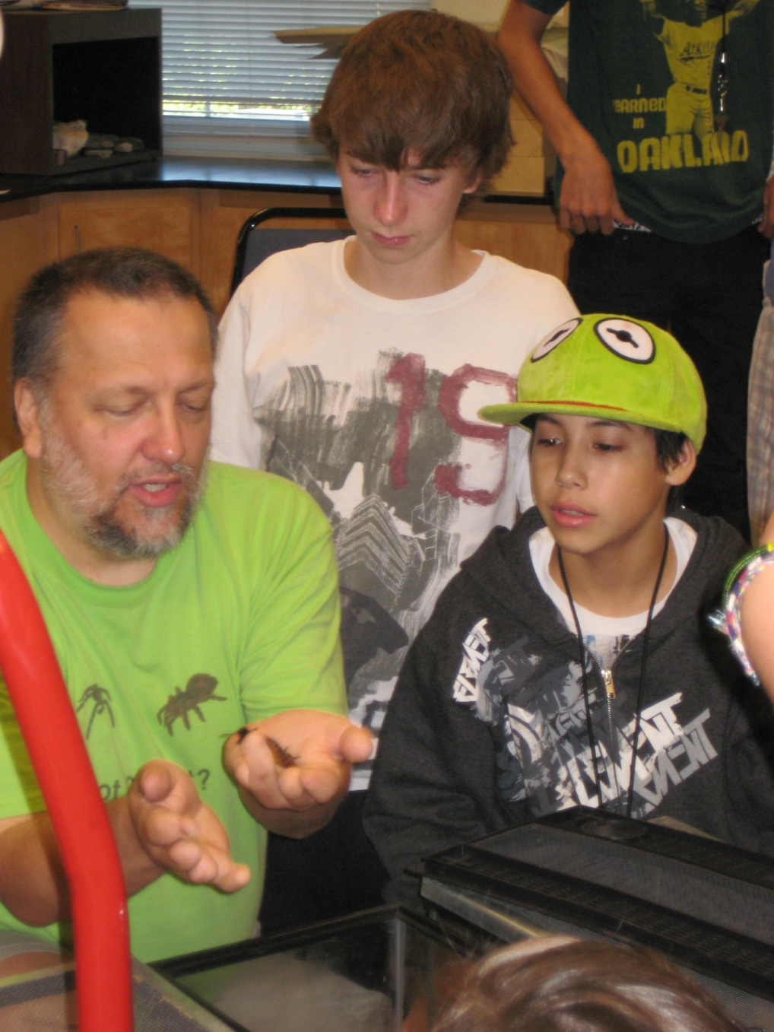
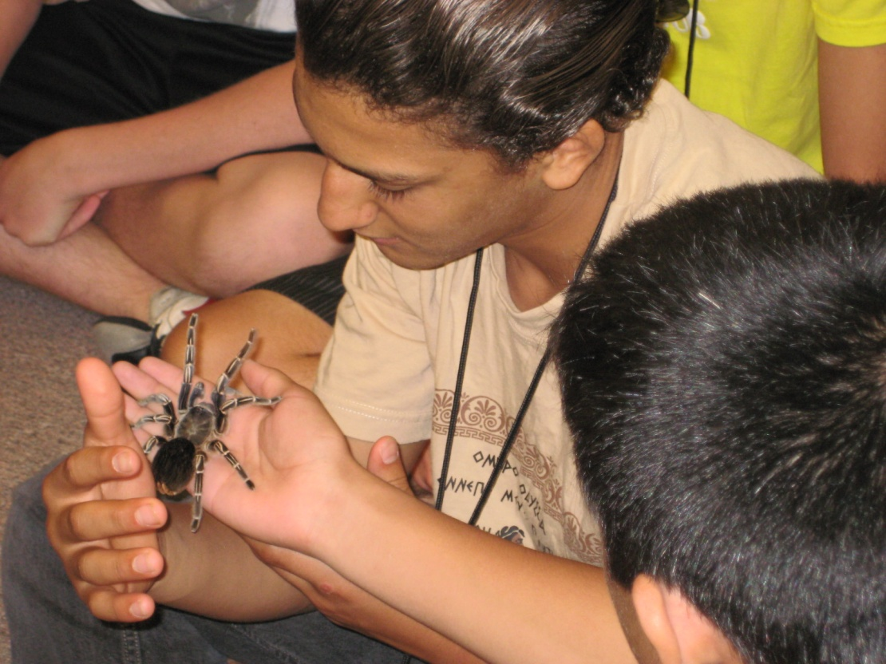

Slide 7
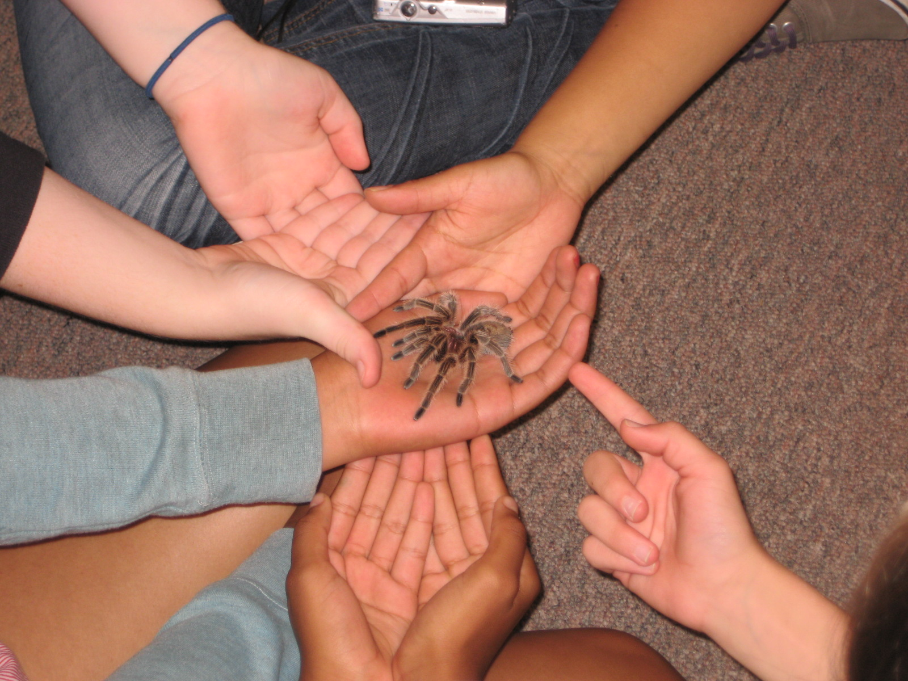

Slide 8
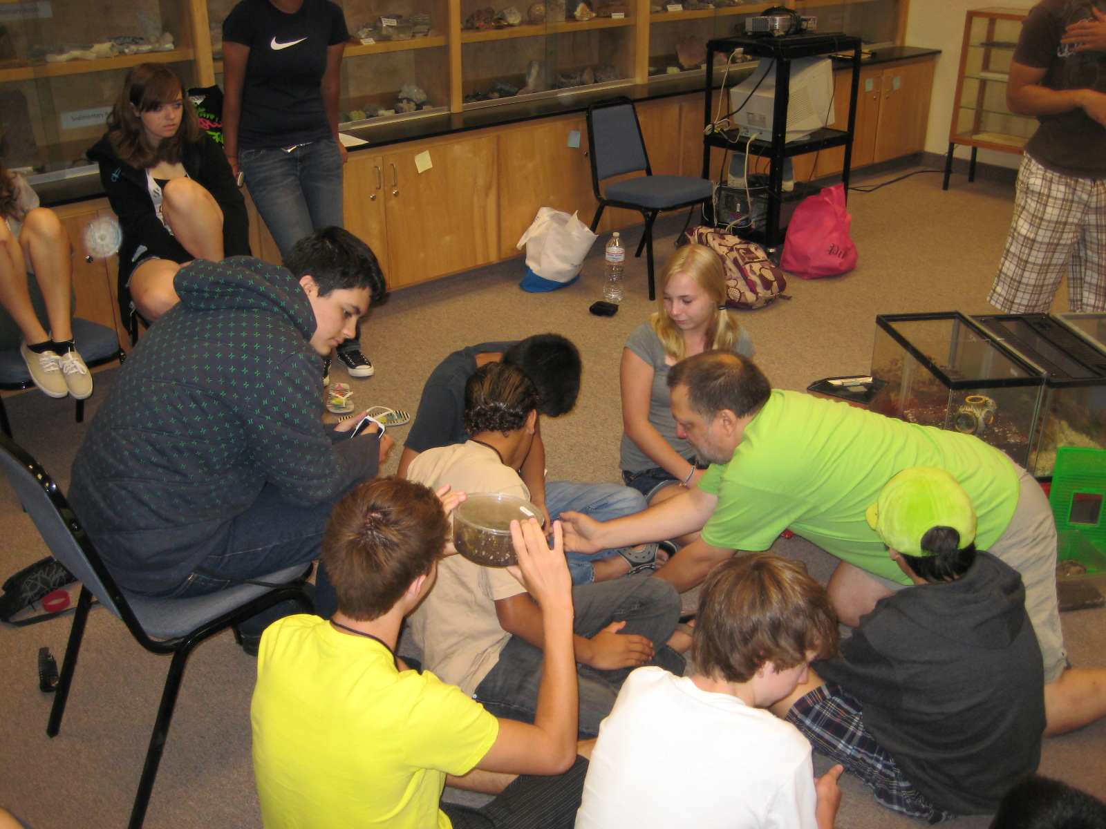

Slide 9
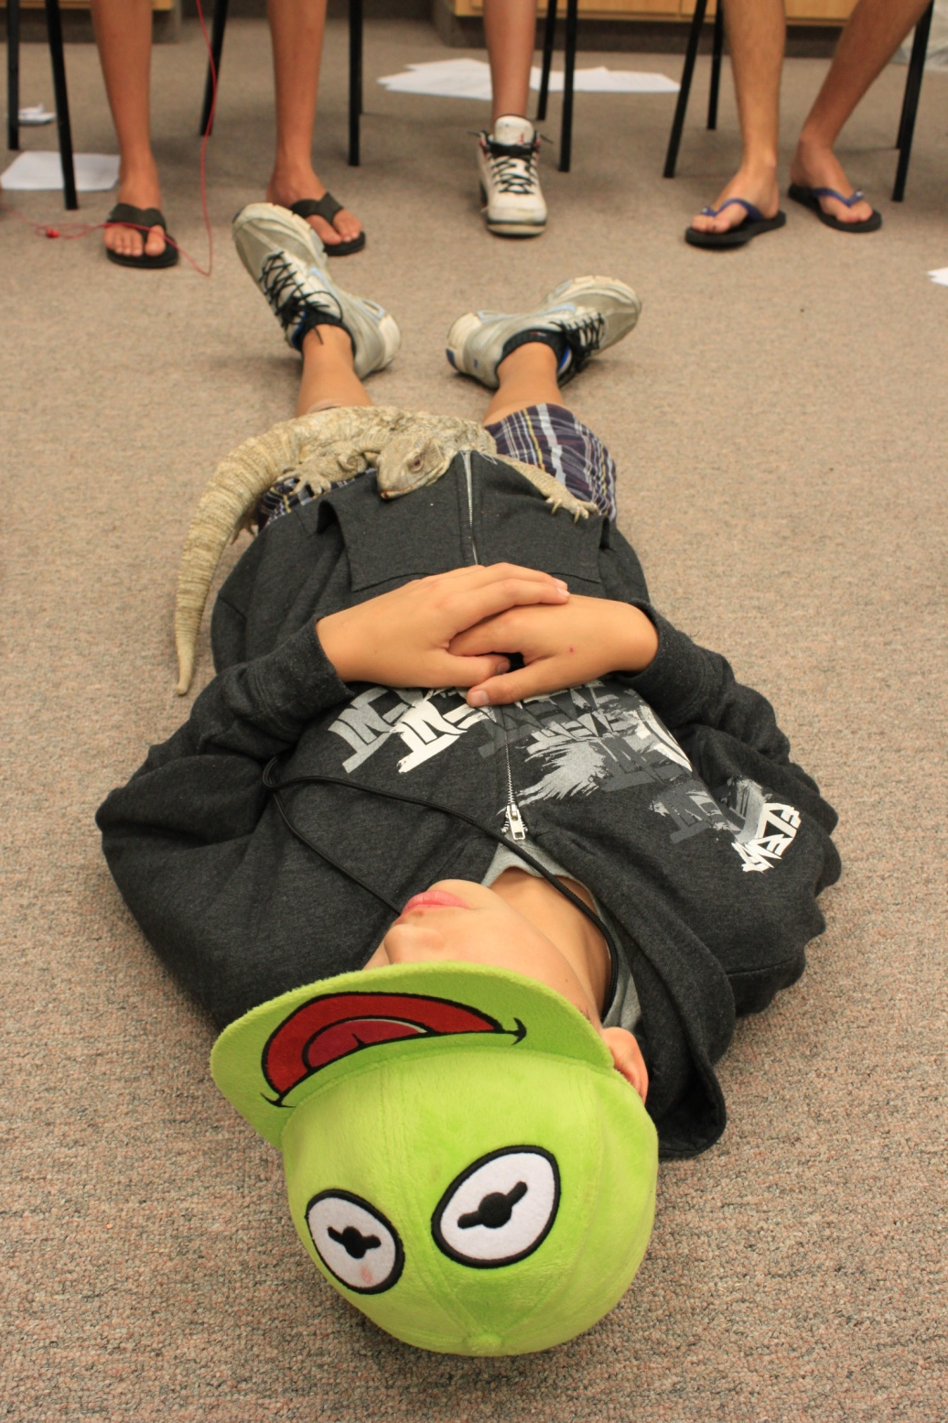
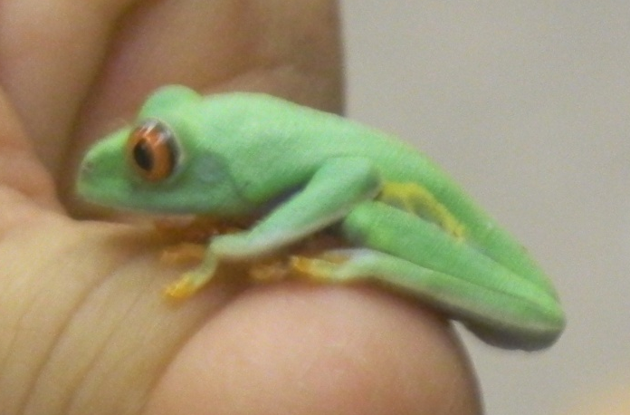

Slide 10
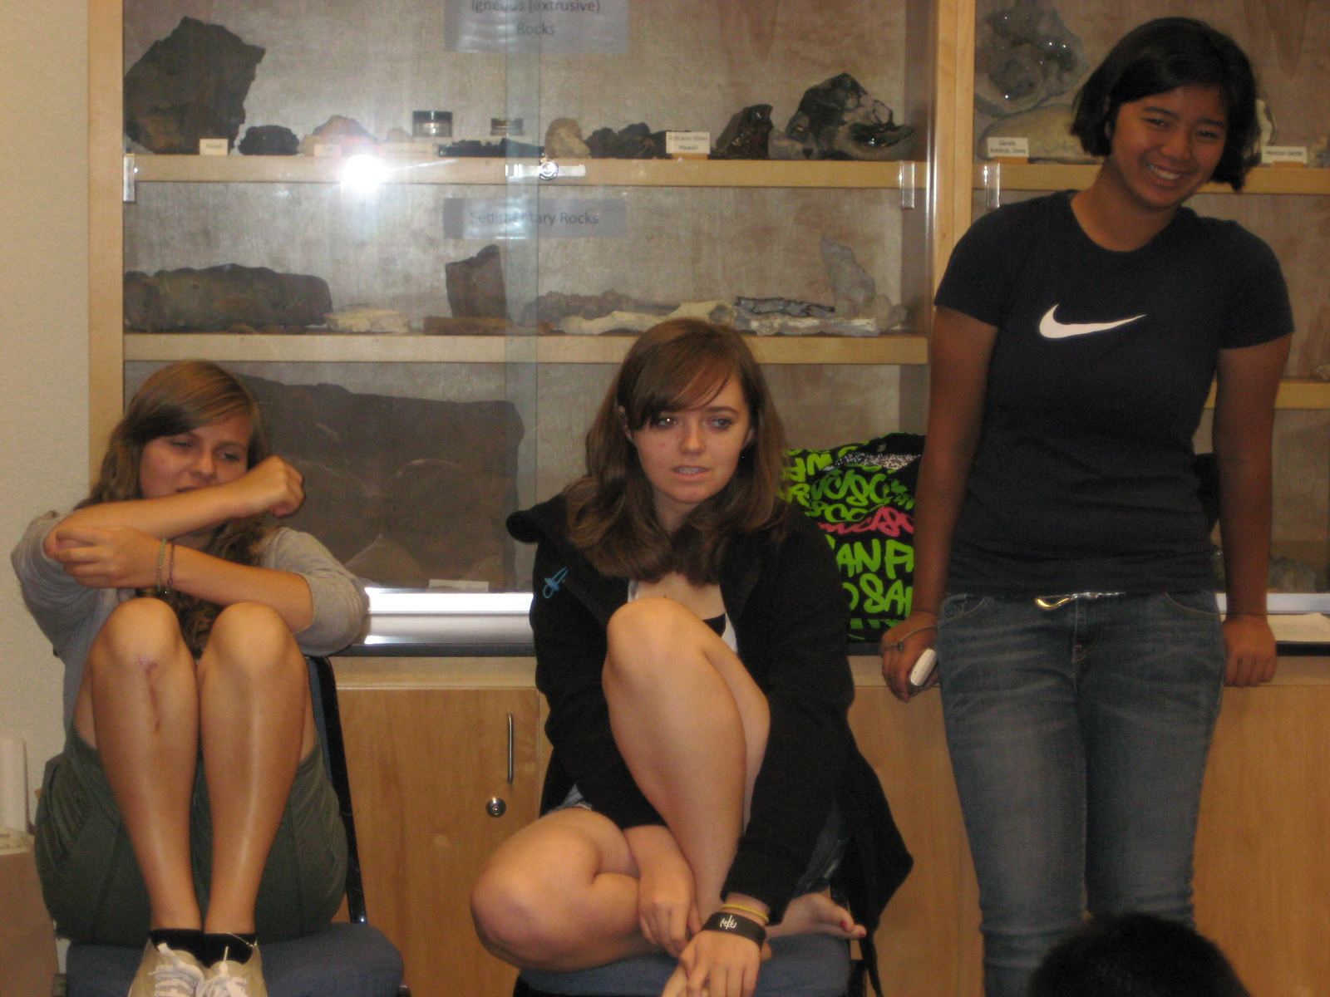

Slide 11
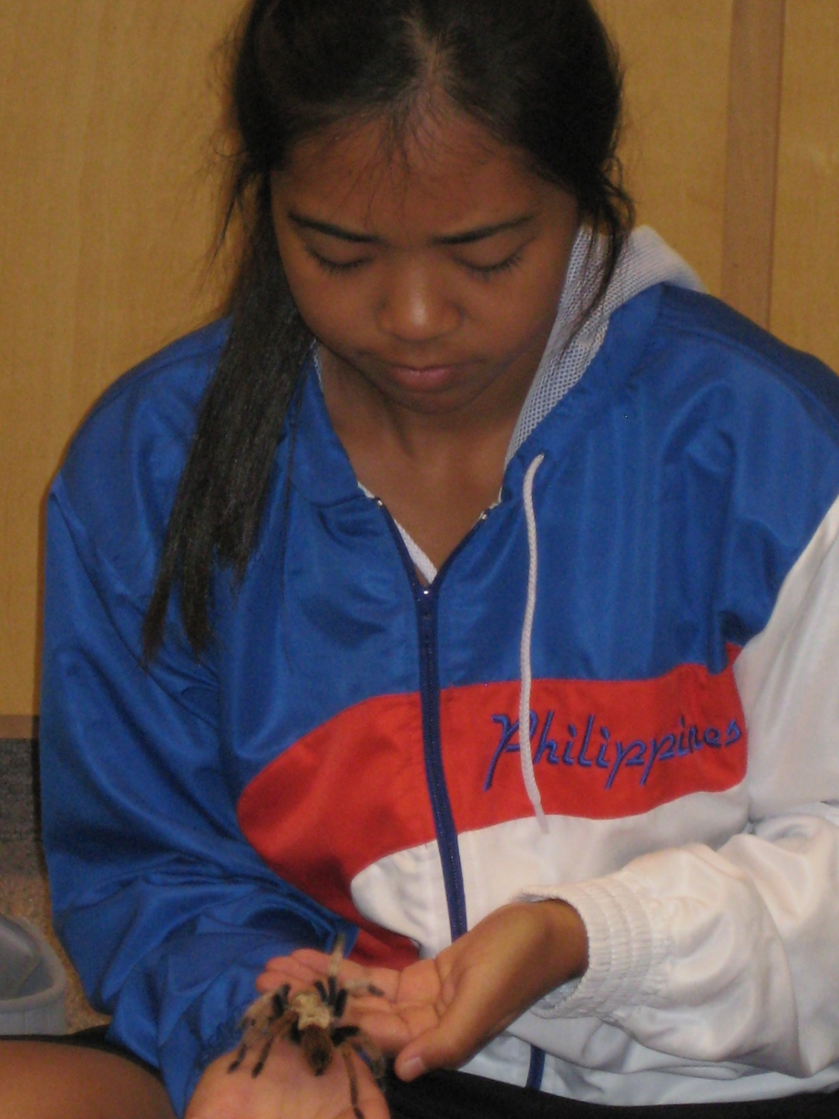
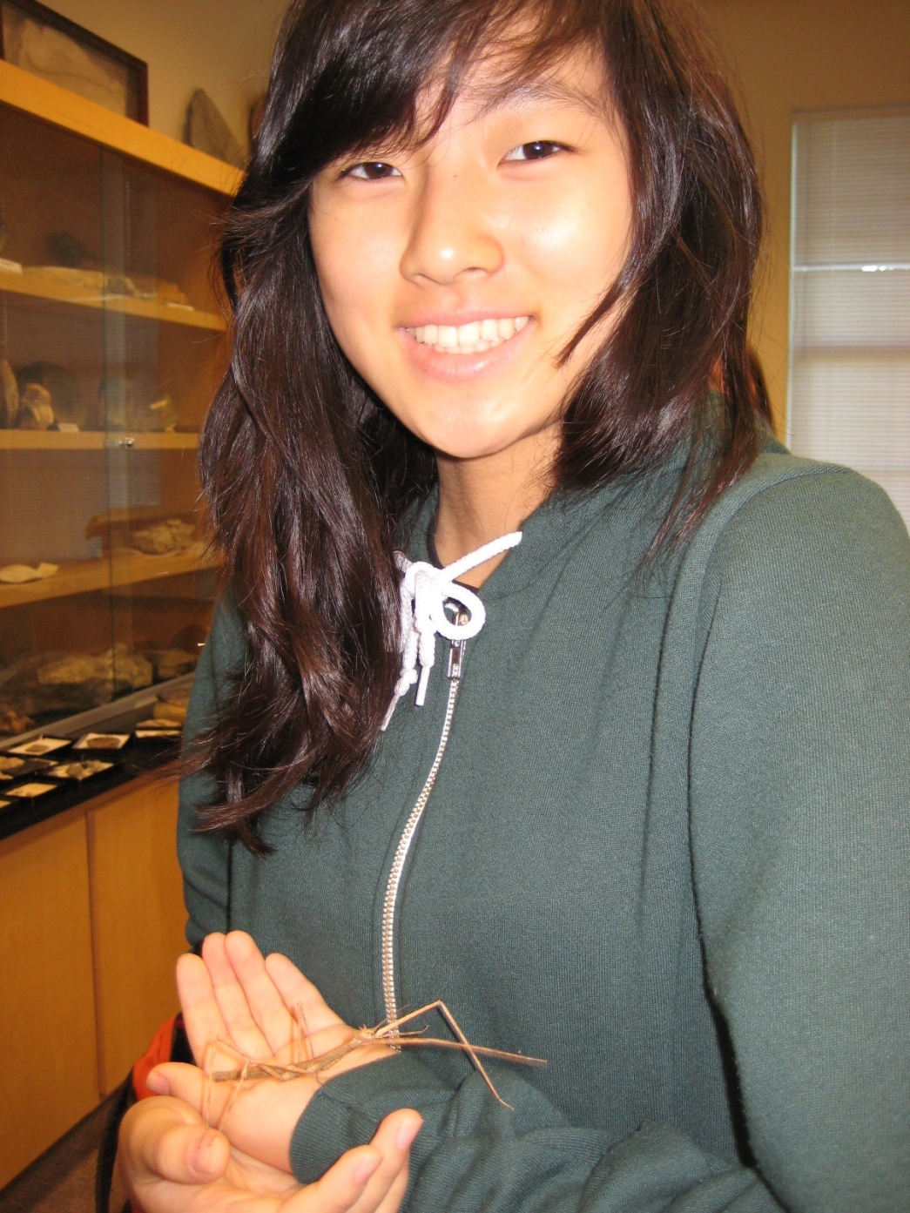

Slide 12
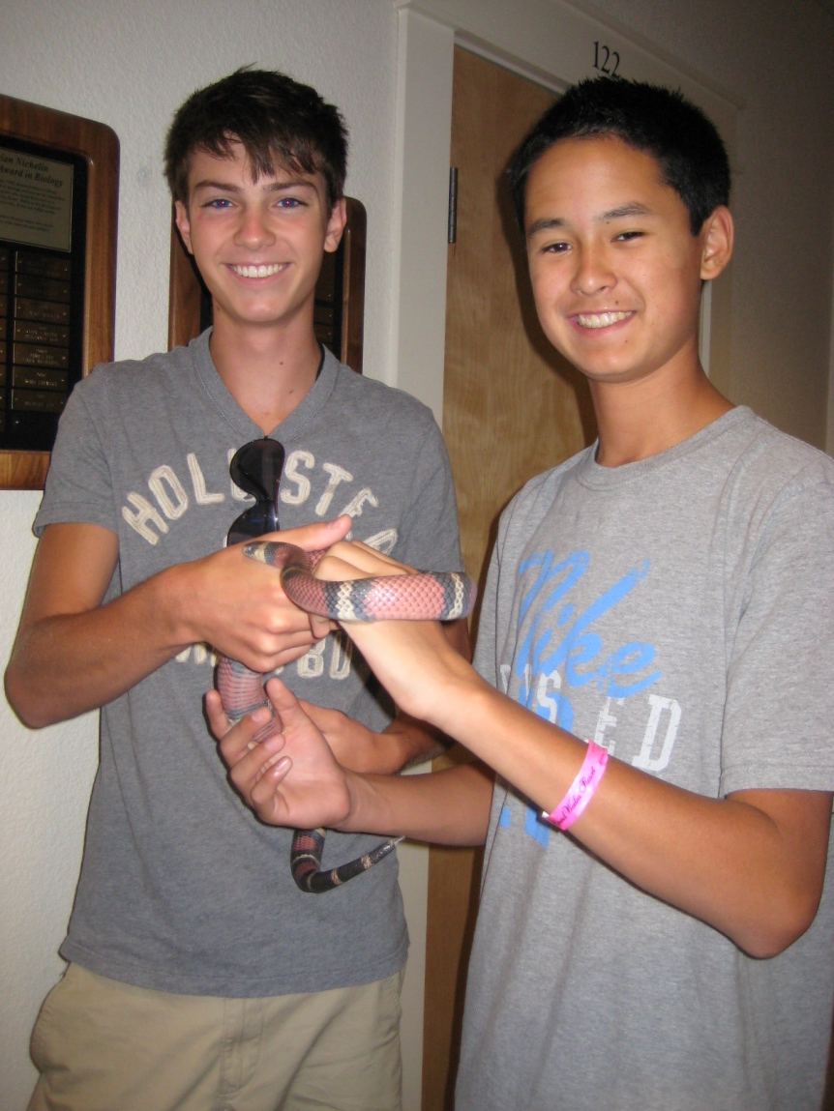
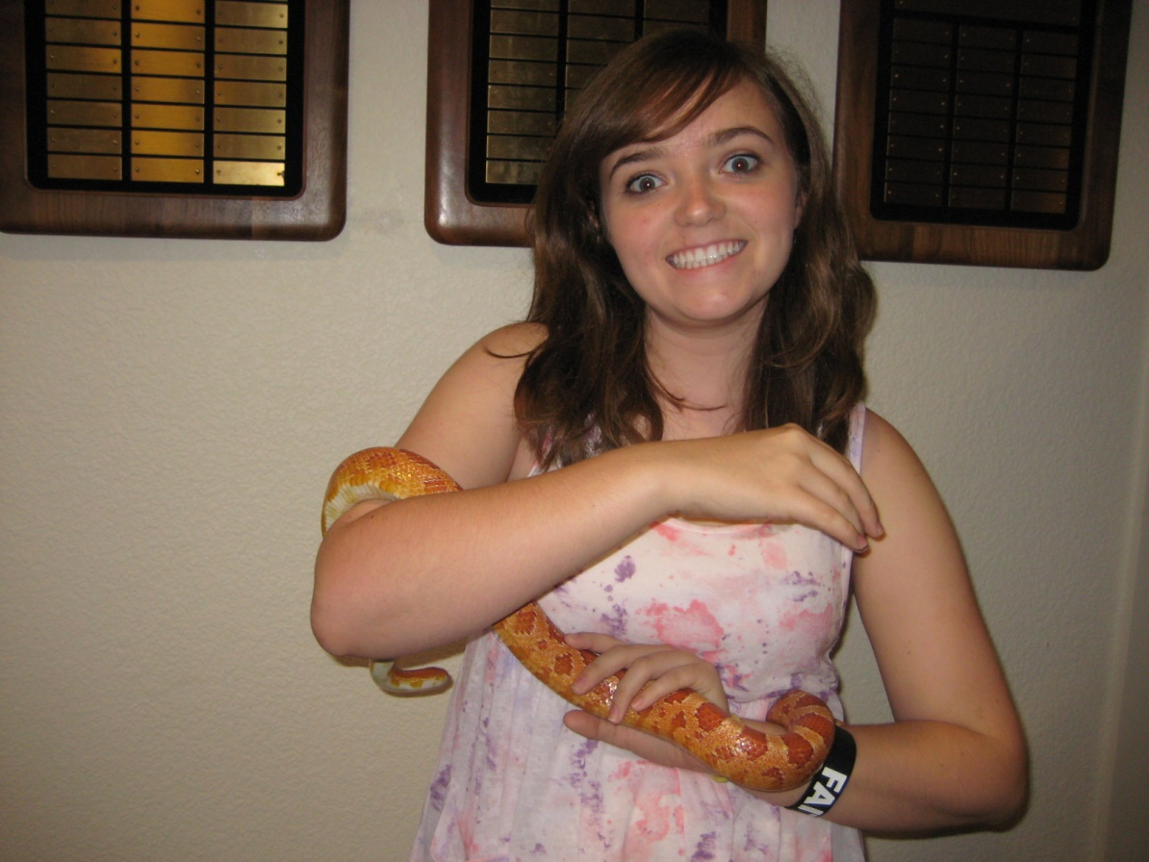

Slide 13
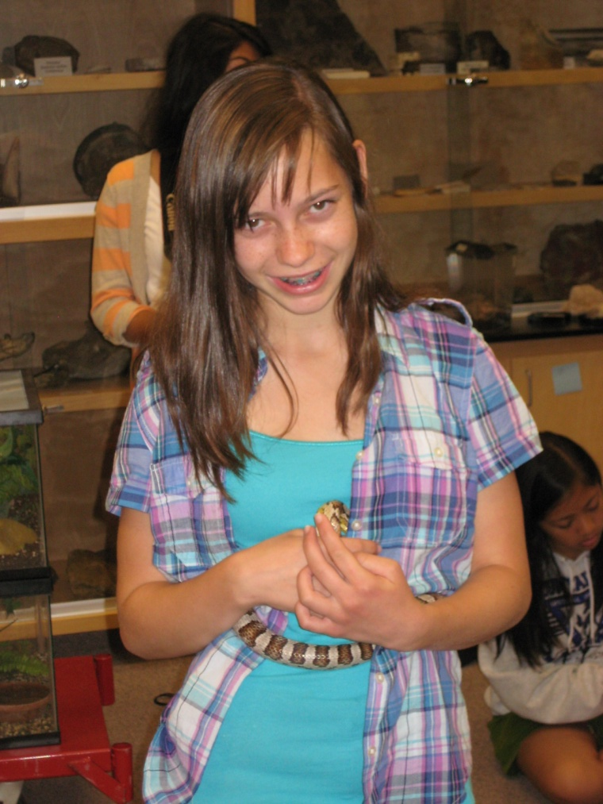
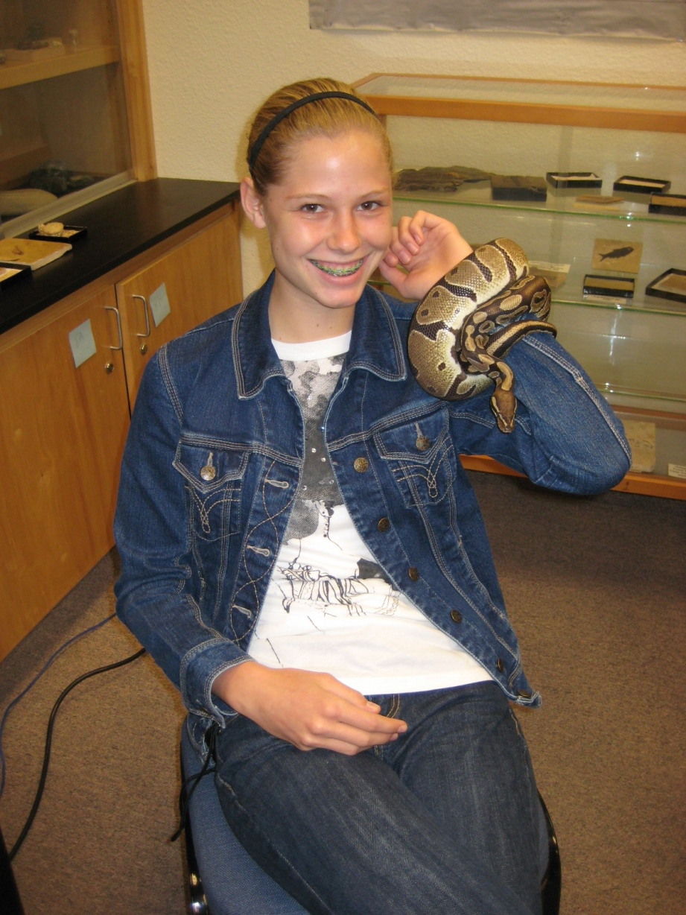

Slide 14
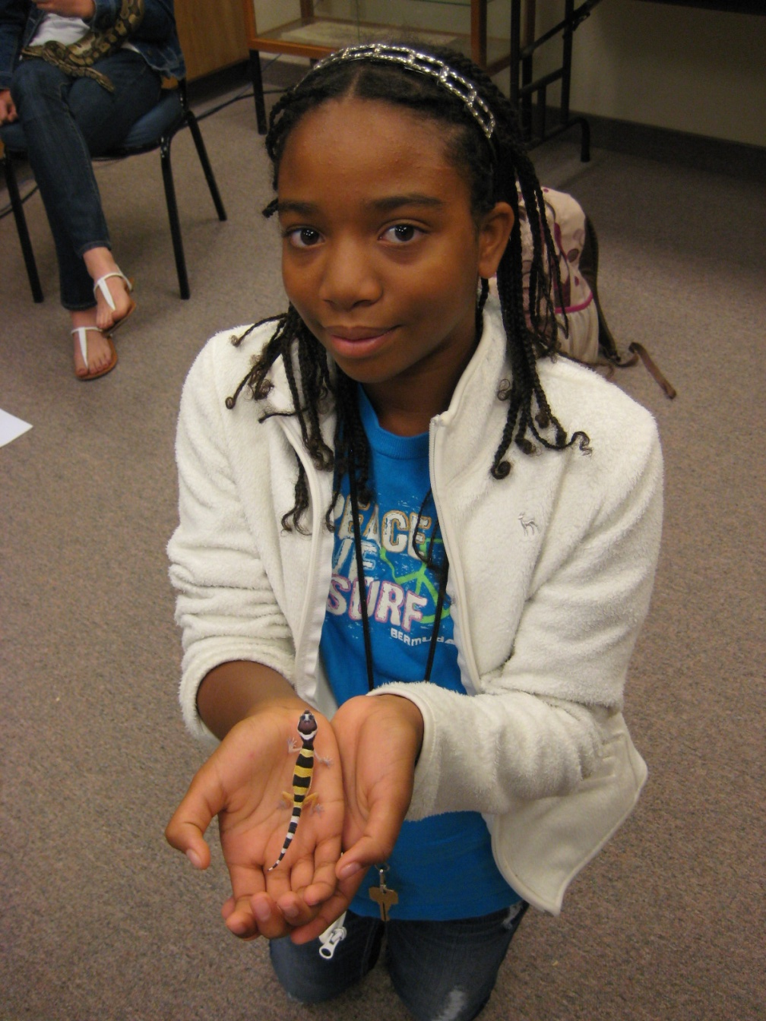
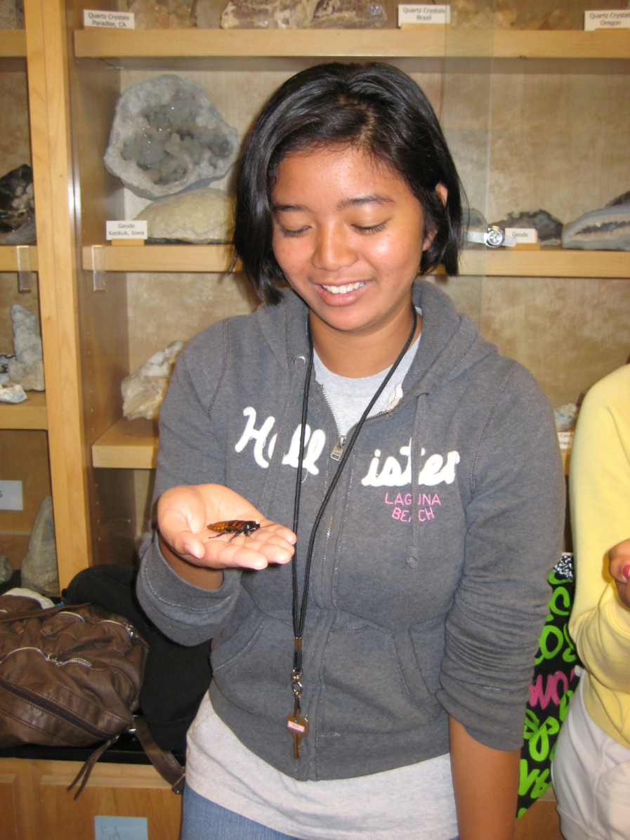

Slide 15
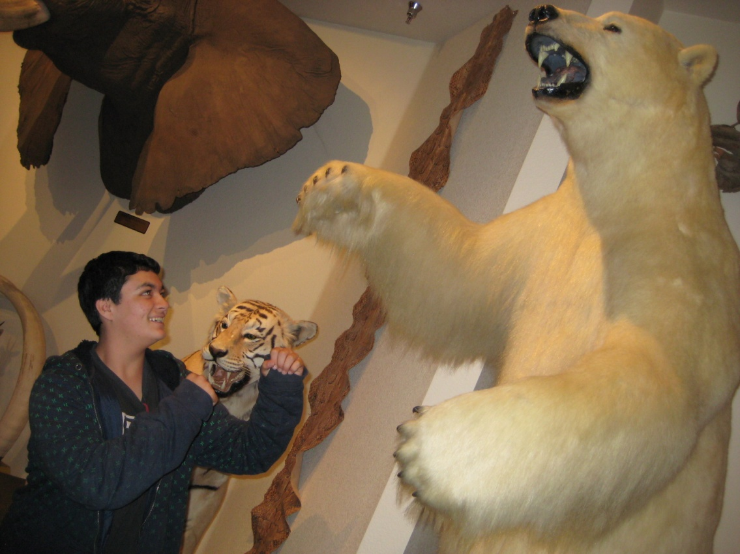
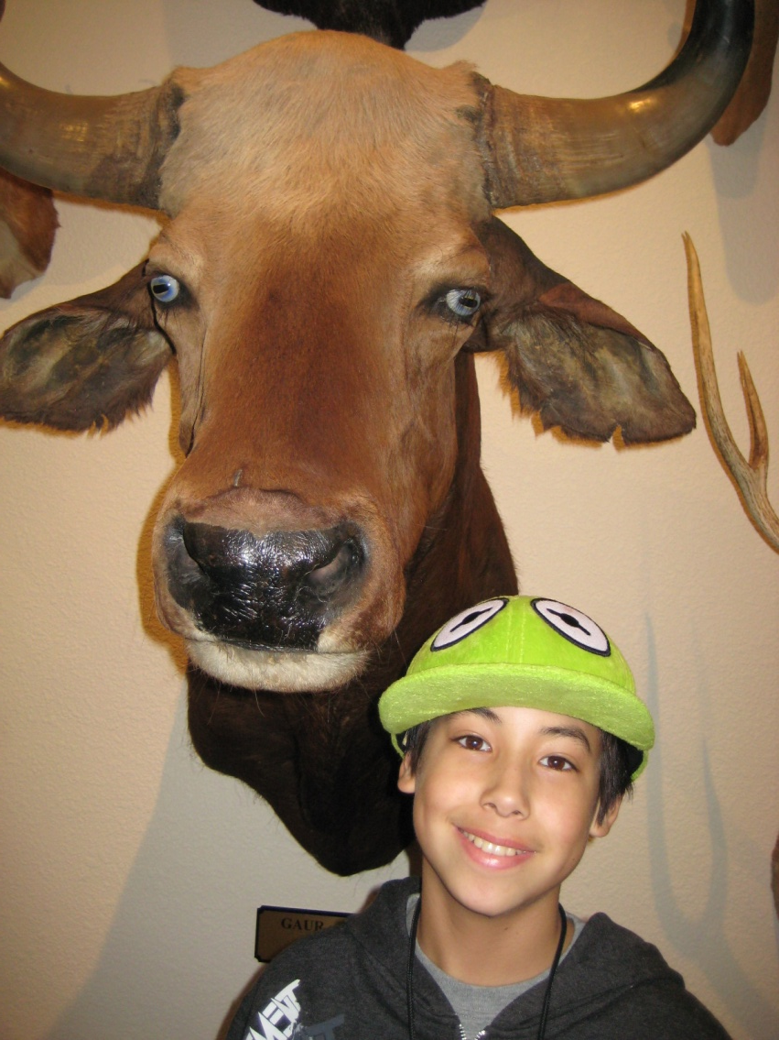

Slide 16
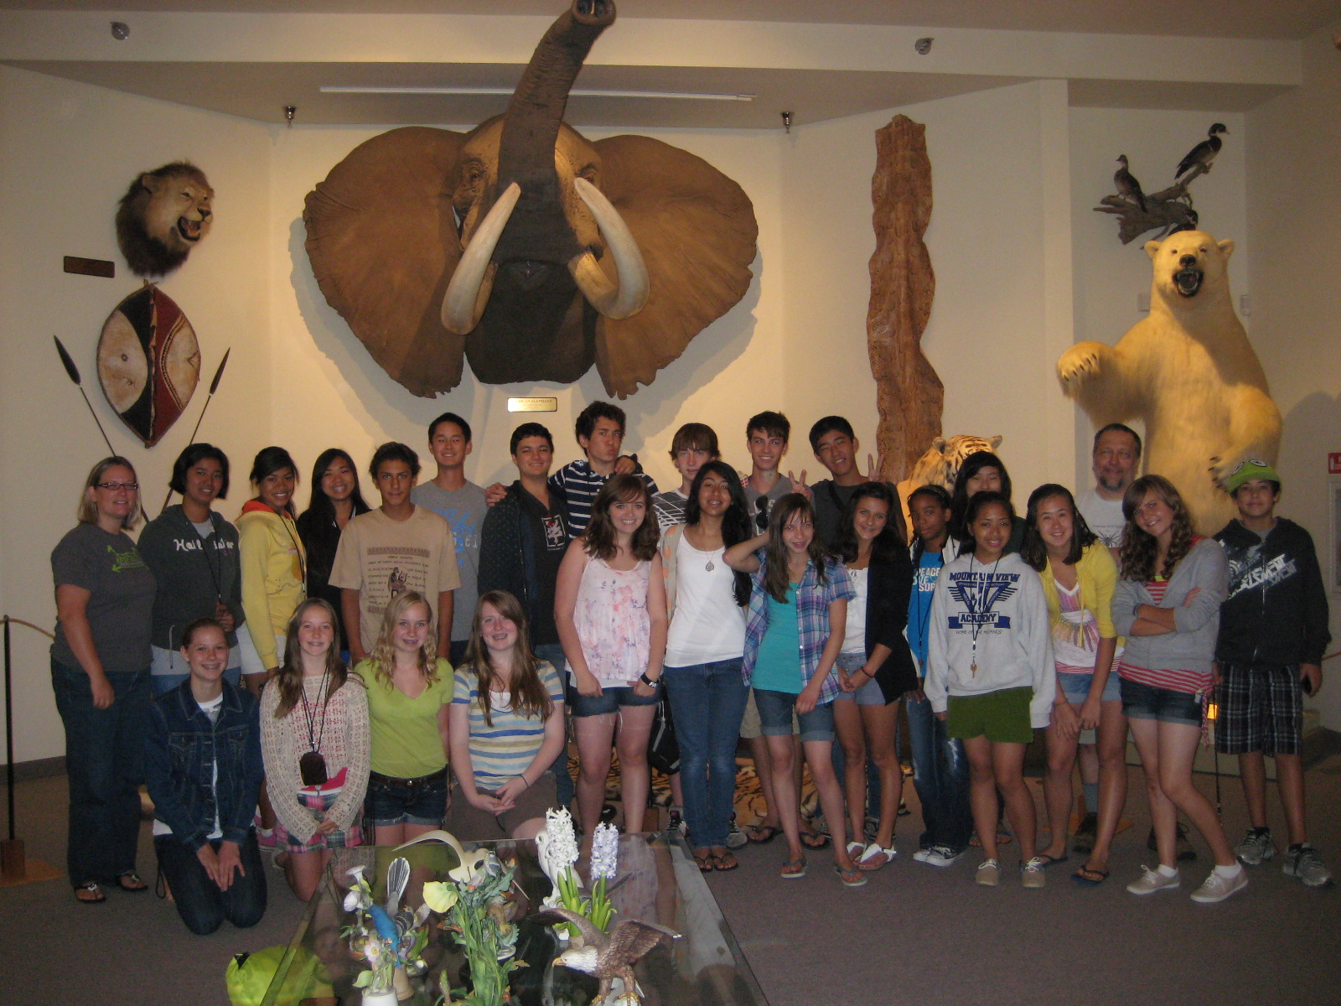

Slide 17
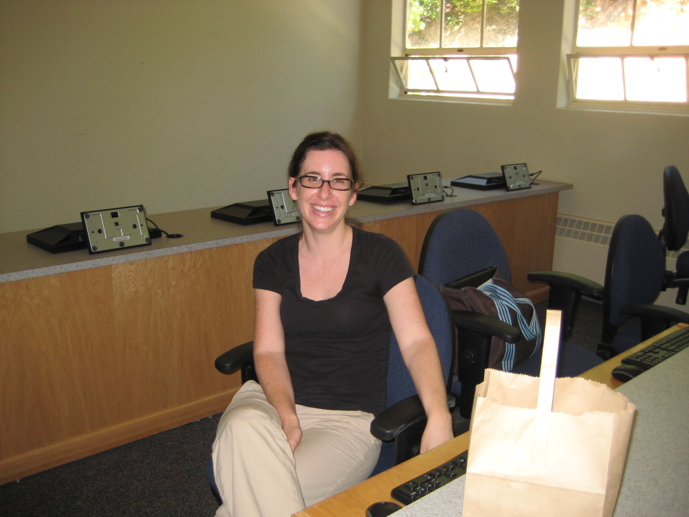
Creative Writing
Professor Sara Kakazu

Slide 18
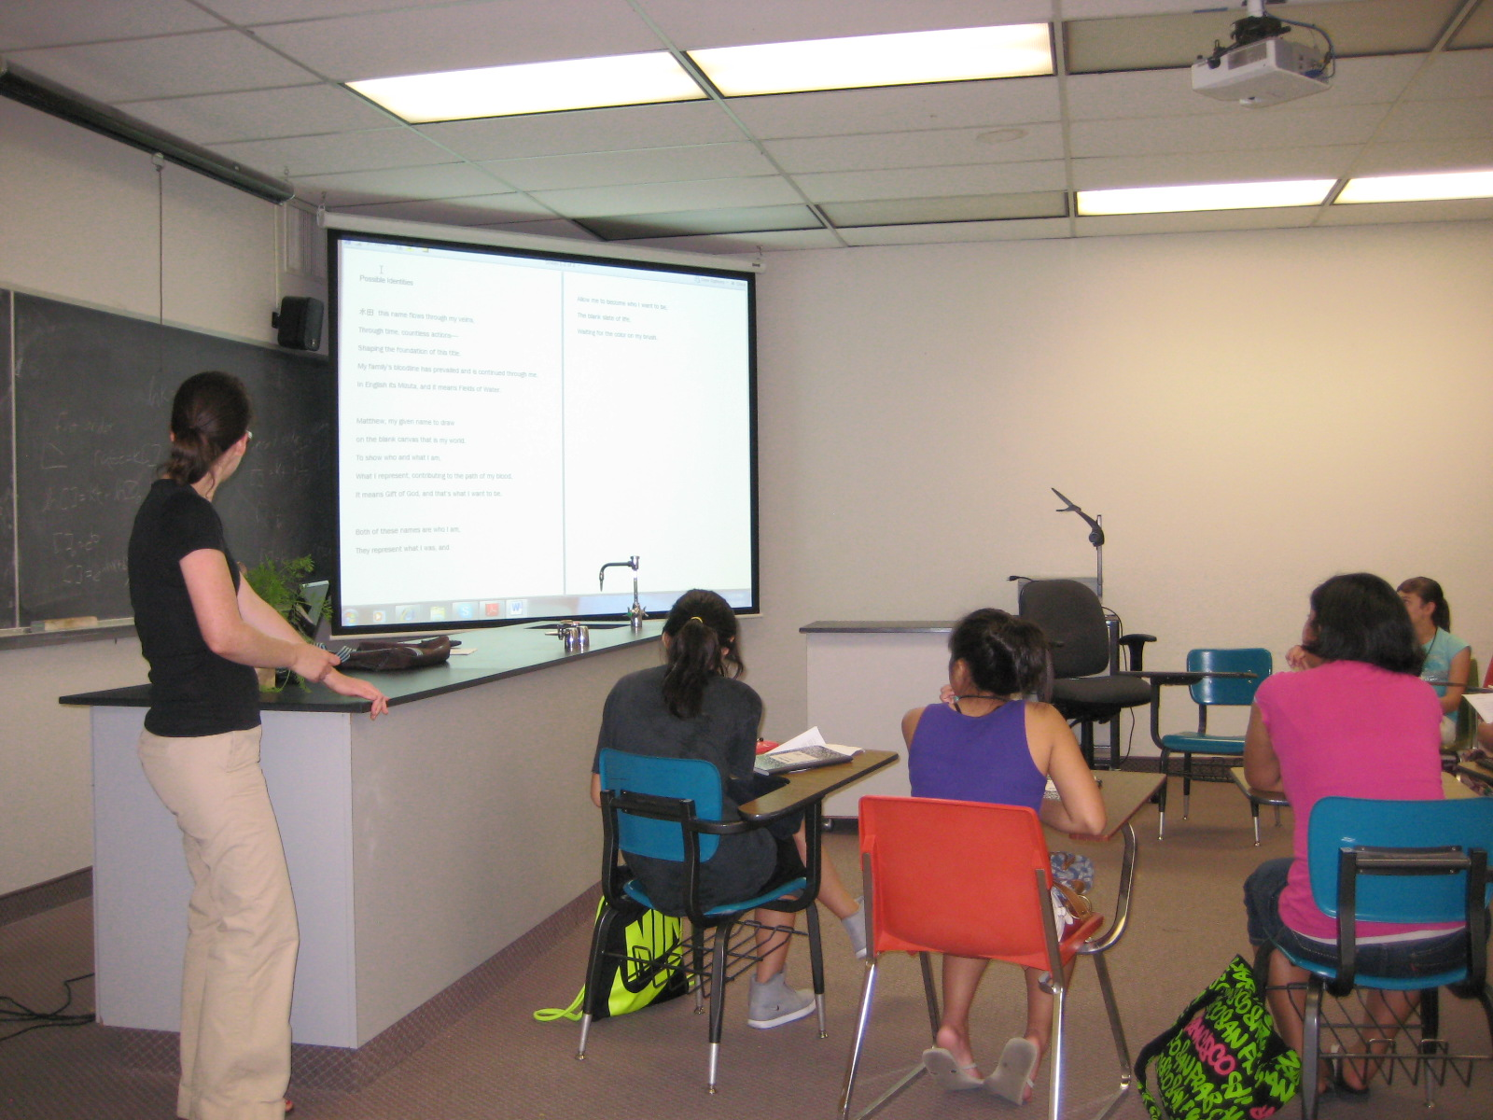

Slide 19
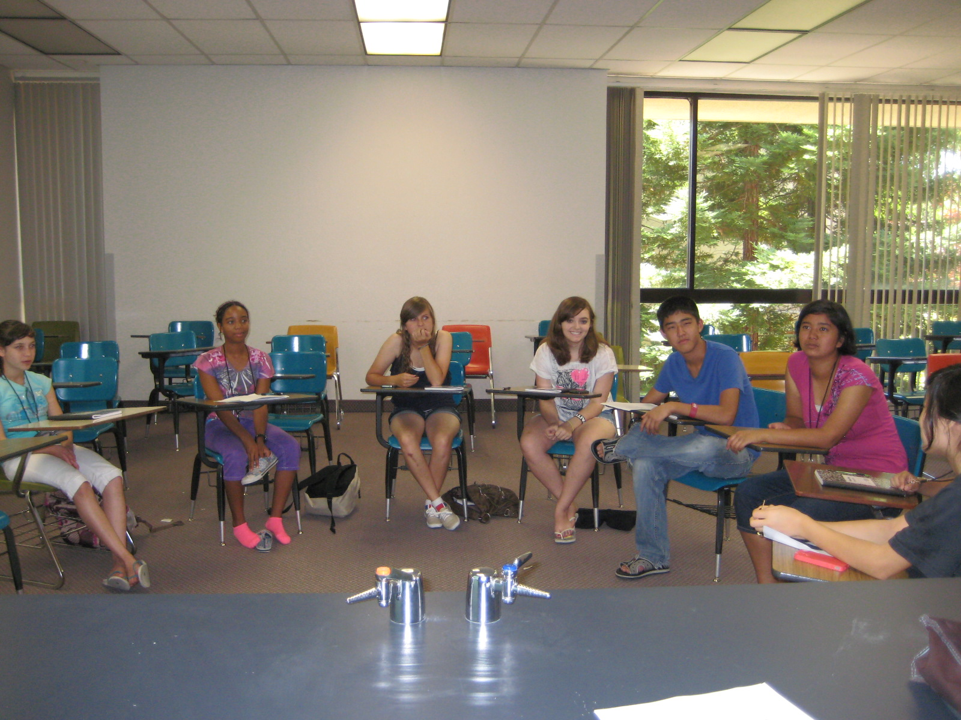

Slide 20
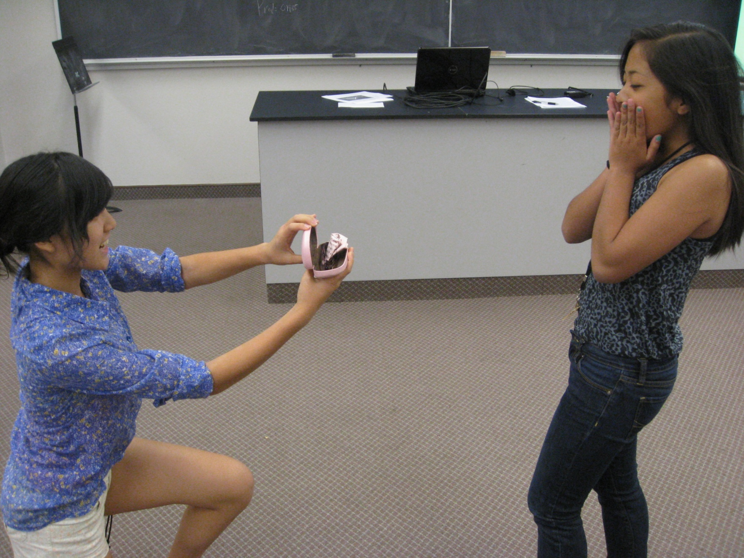

Slide 21
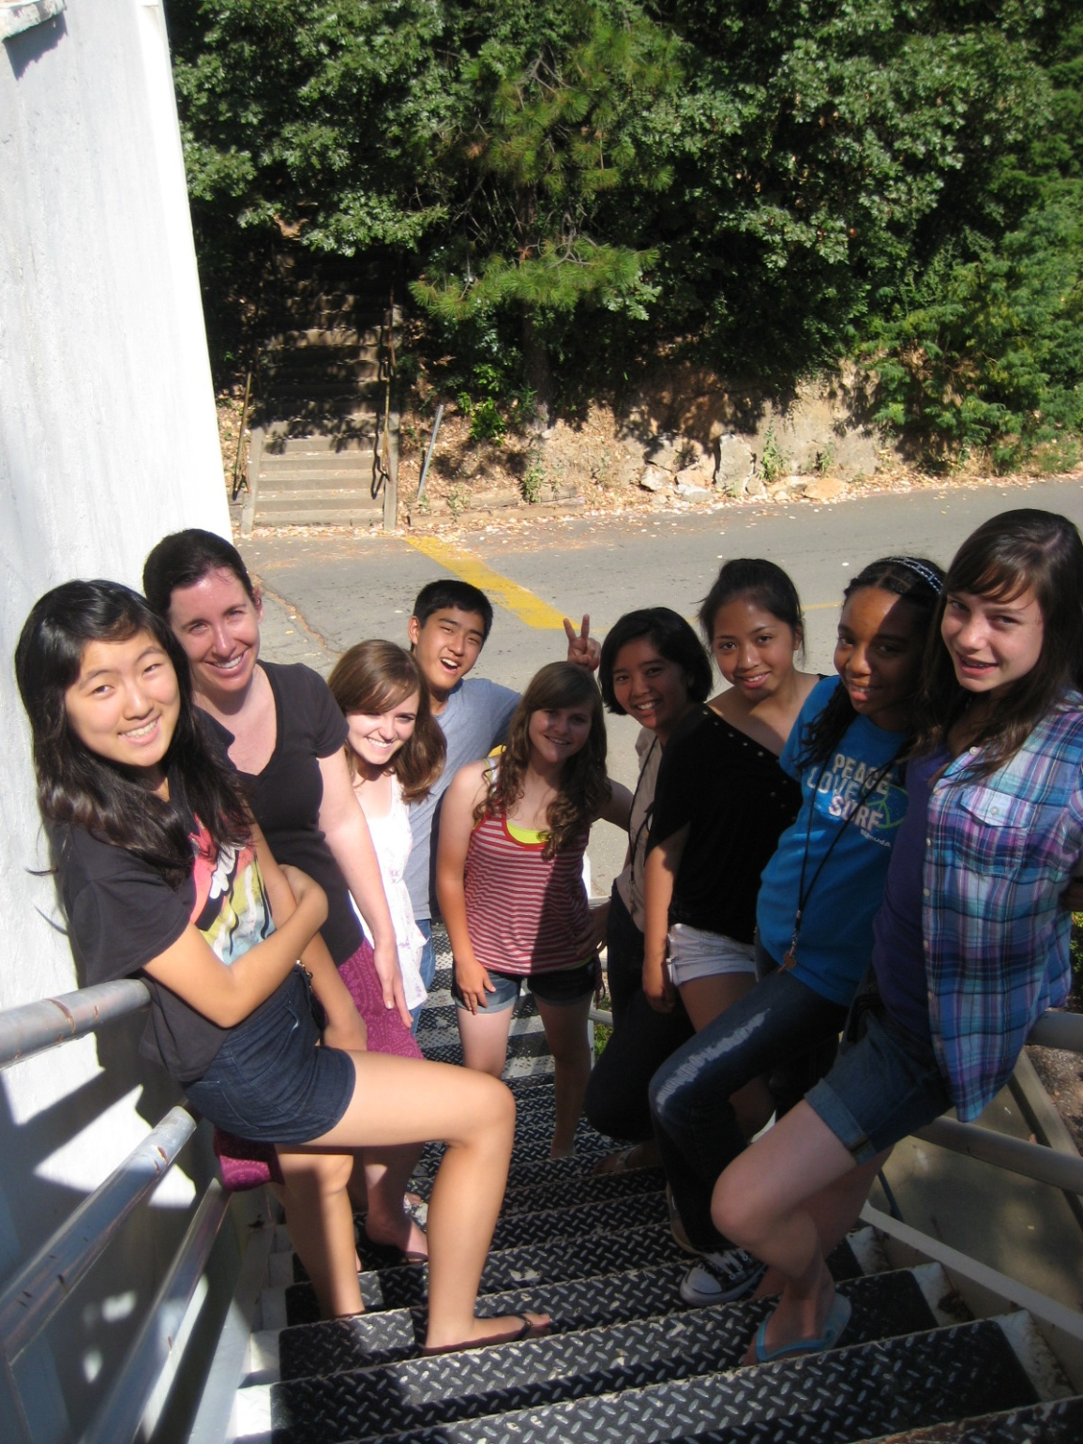

Slide 22
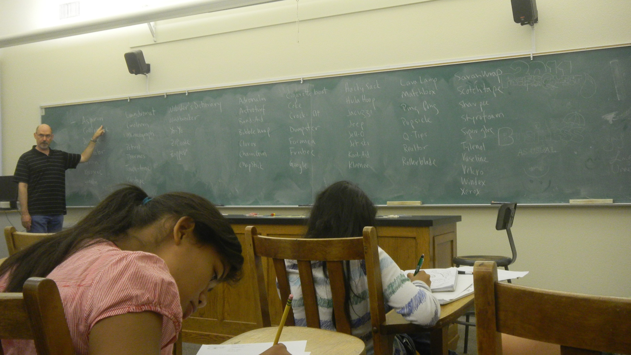
Business
Dr. Wally Lighthouse

Slide 23
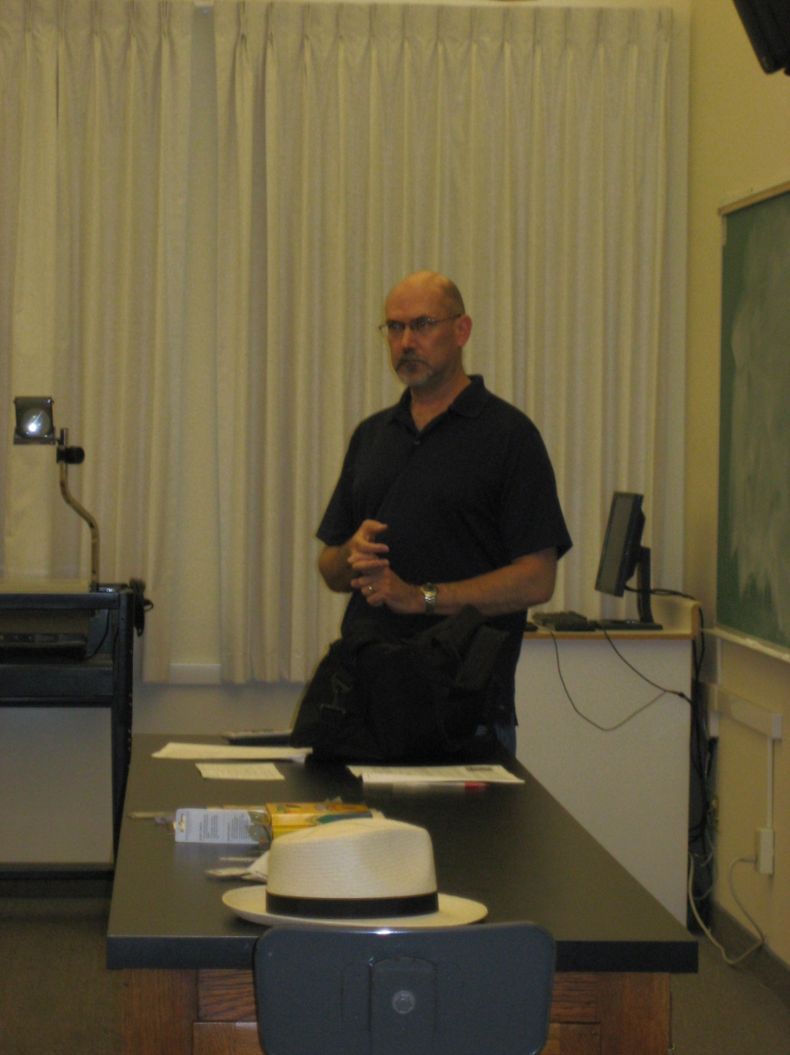

Slide 24
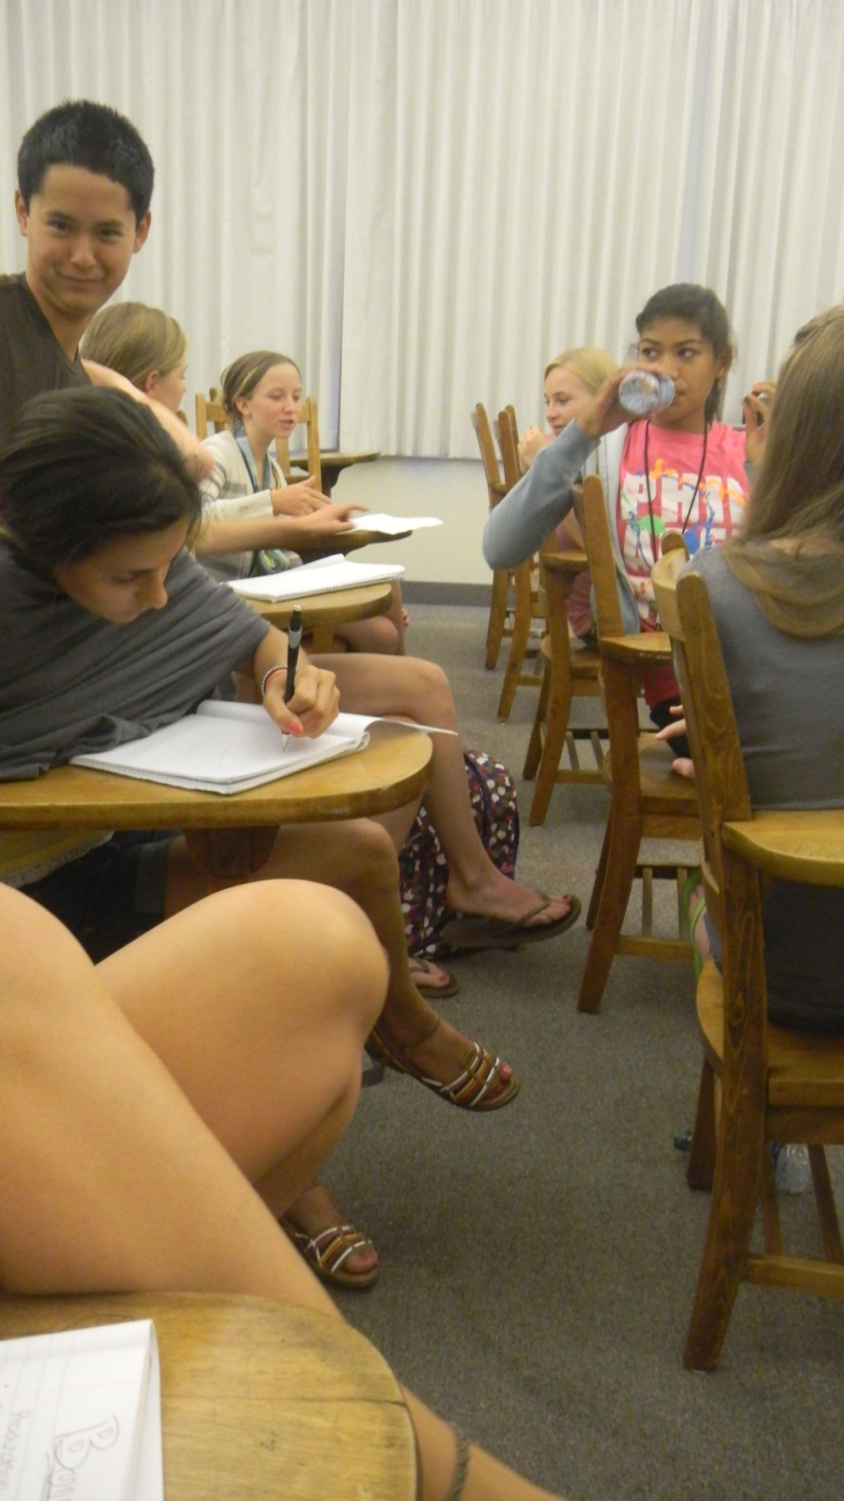
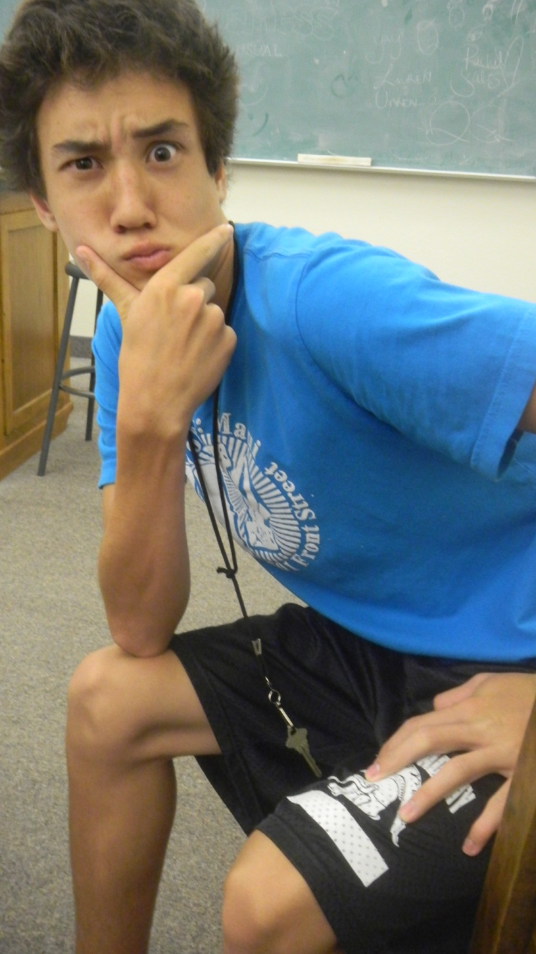

Slide 25
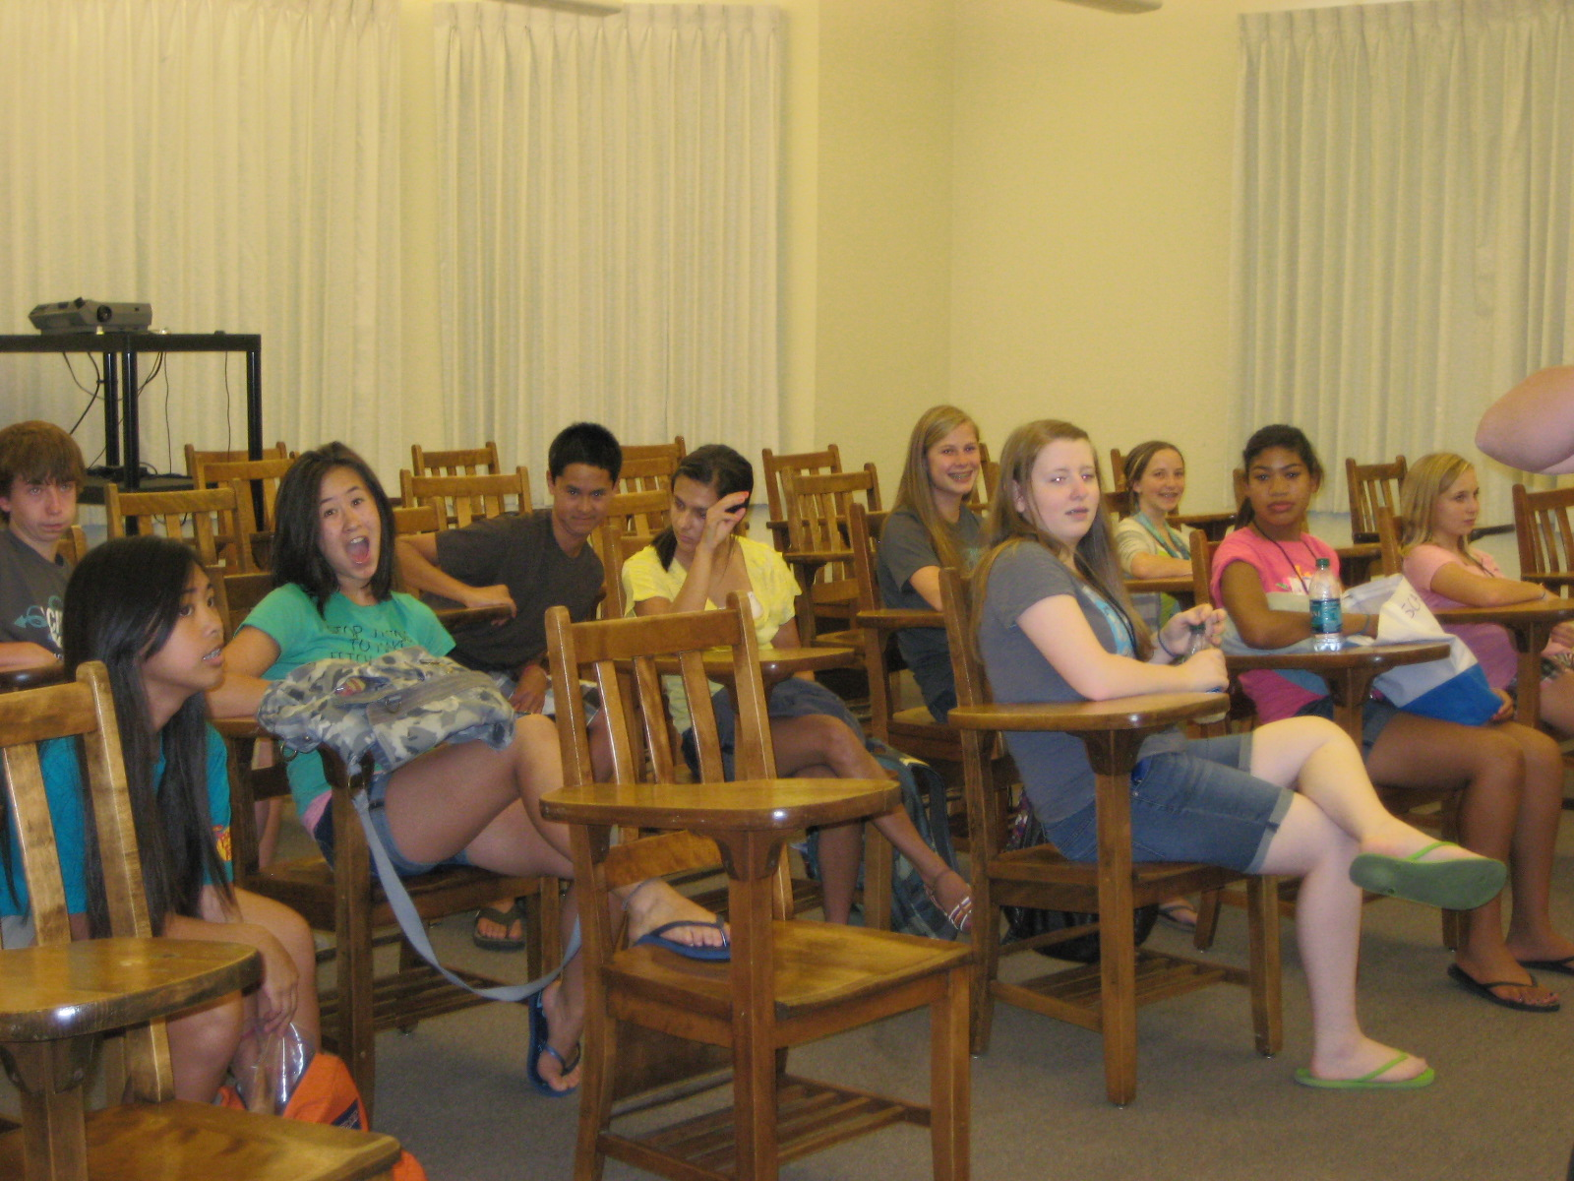

Slide 26
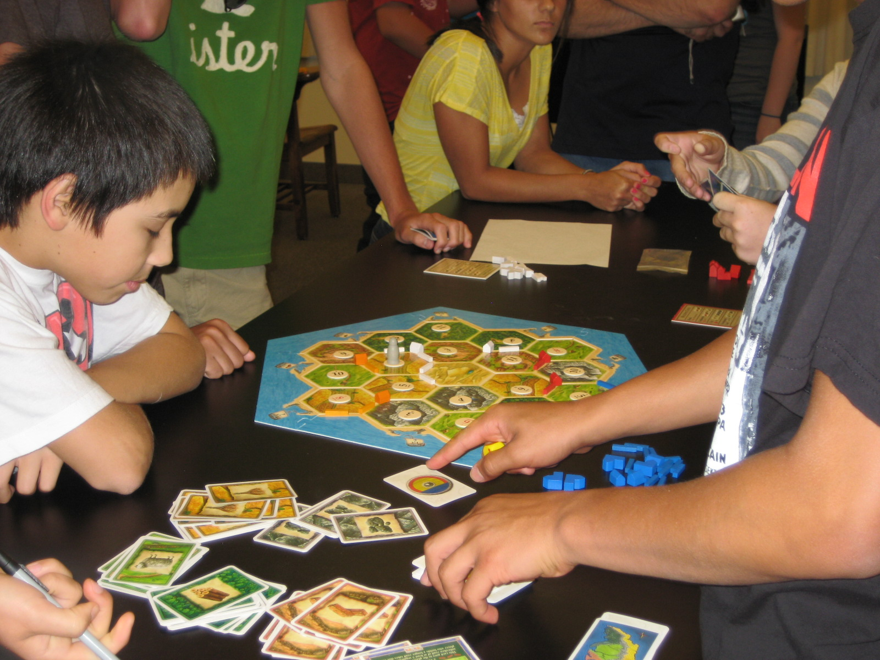

Slide 27
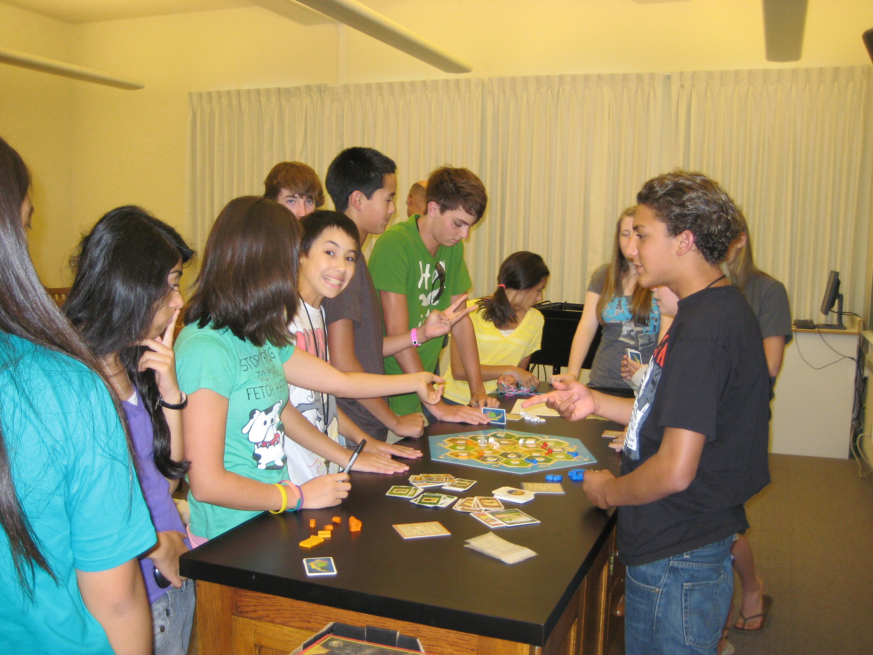

Slide 28
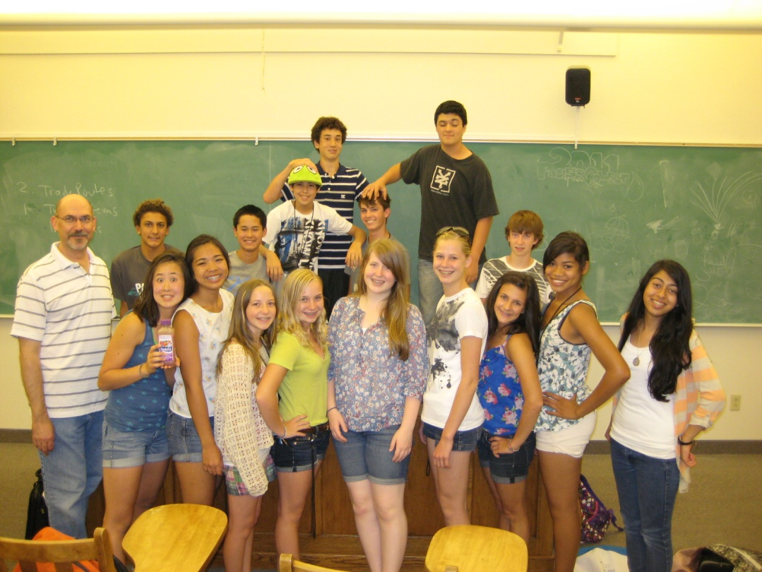

Slide 29
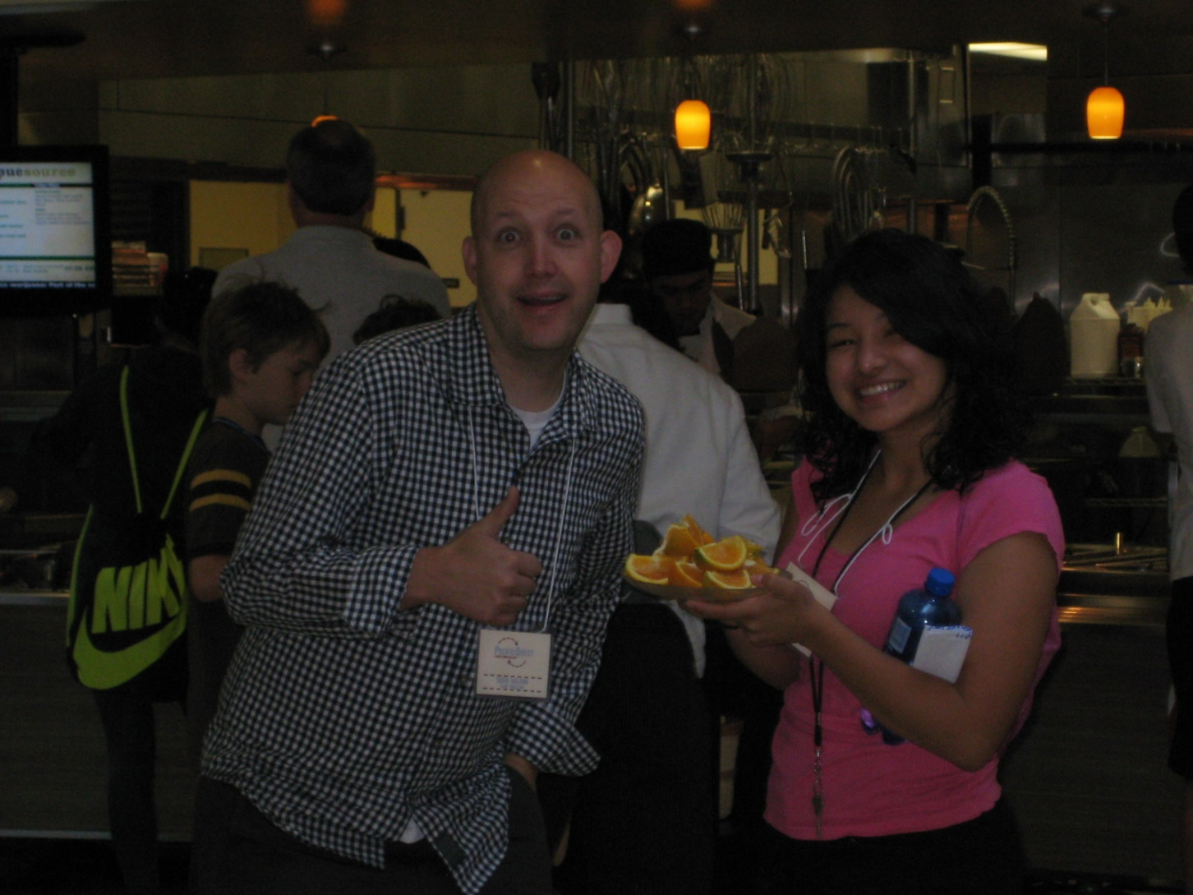
Food!

Slide 30
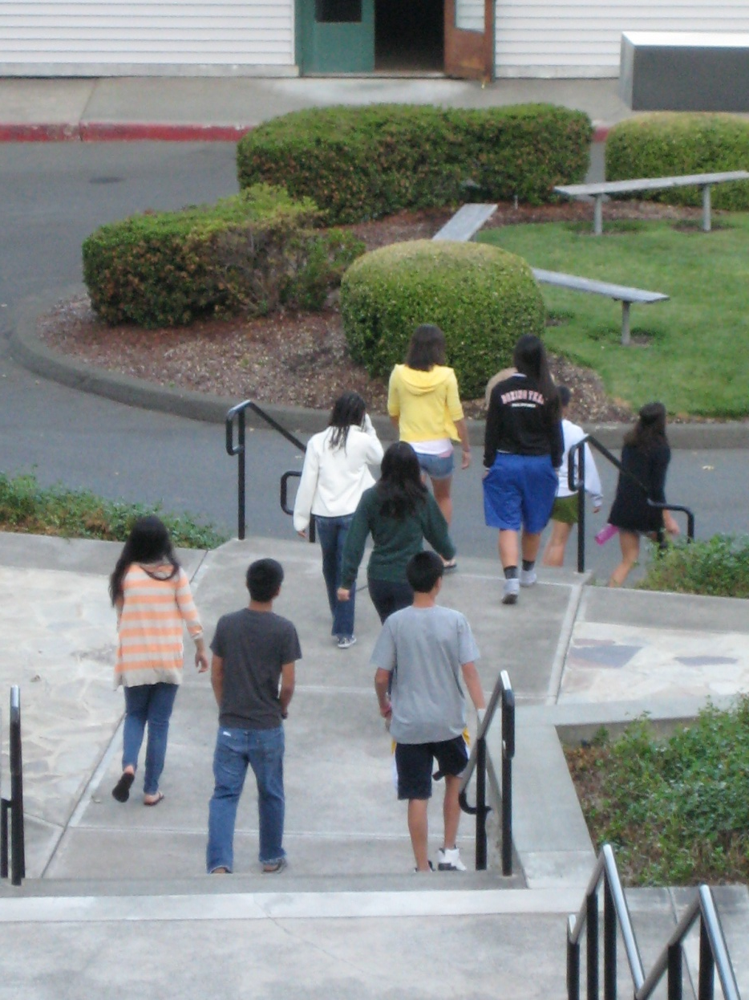
Clark Hall Stairs

Slide 31
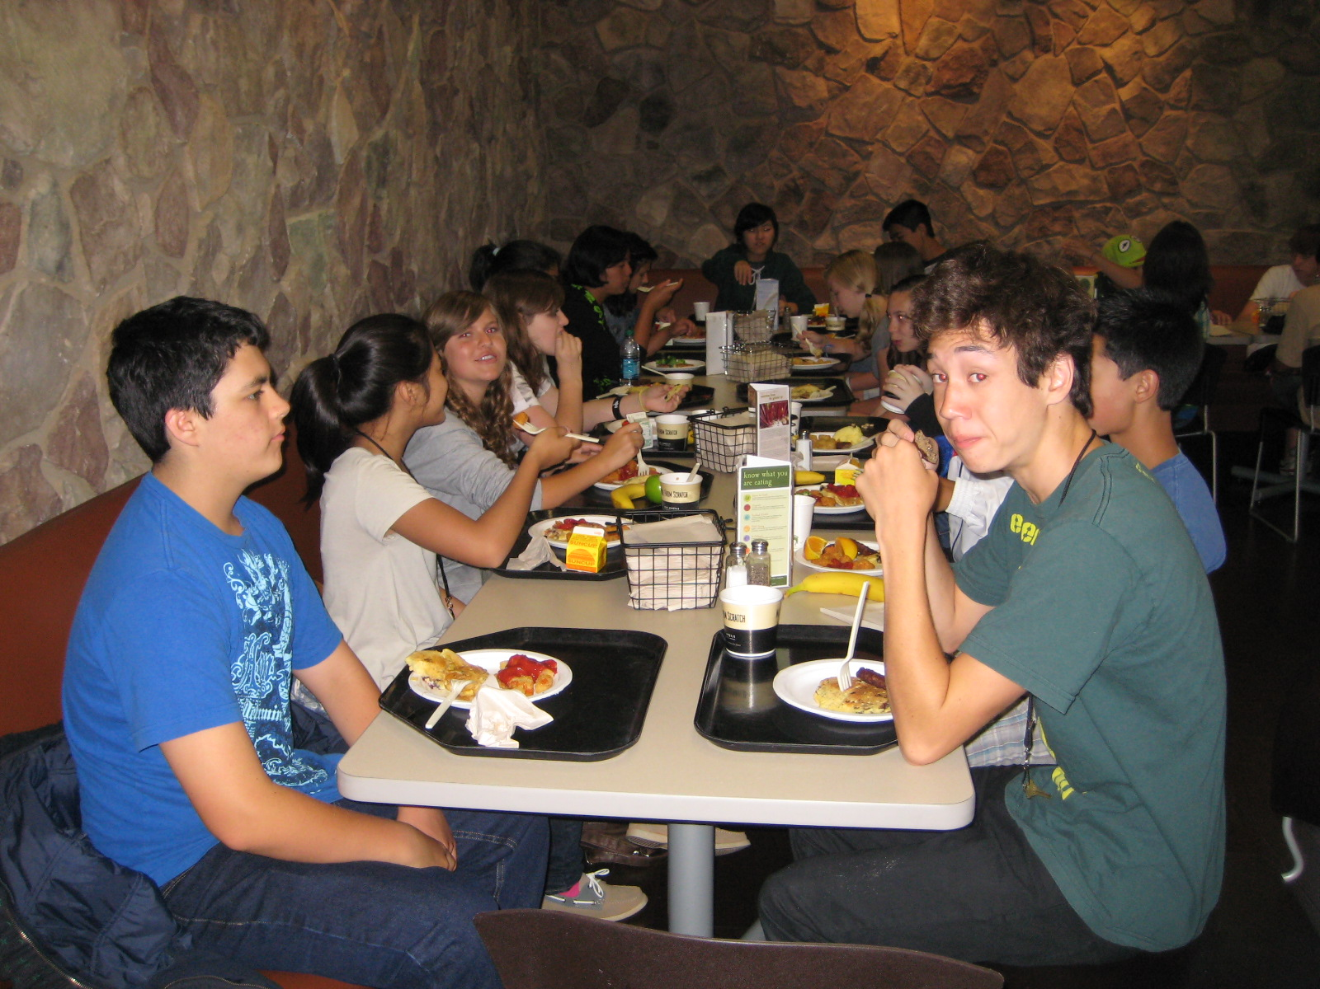

Slide 32
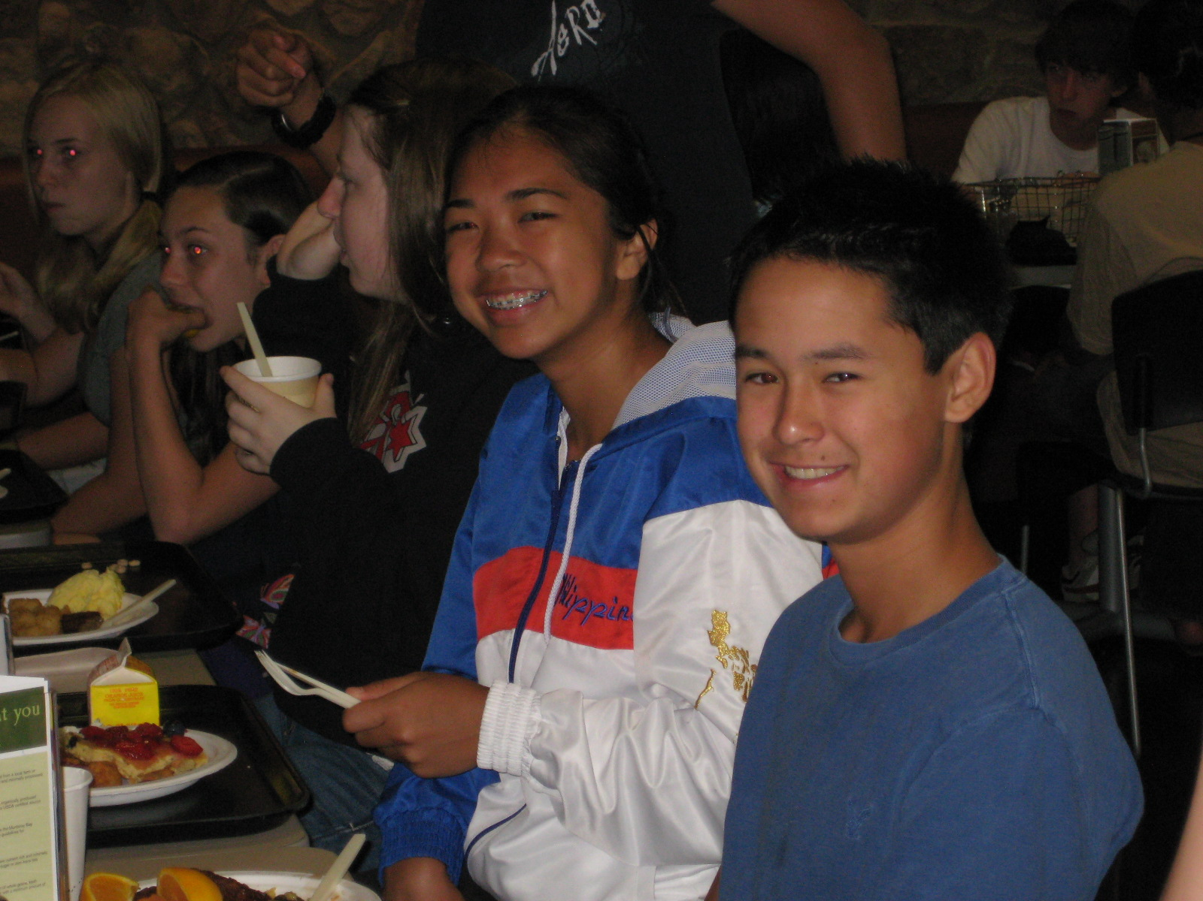

Slide 33
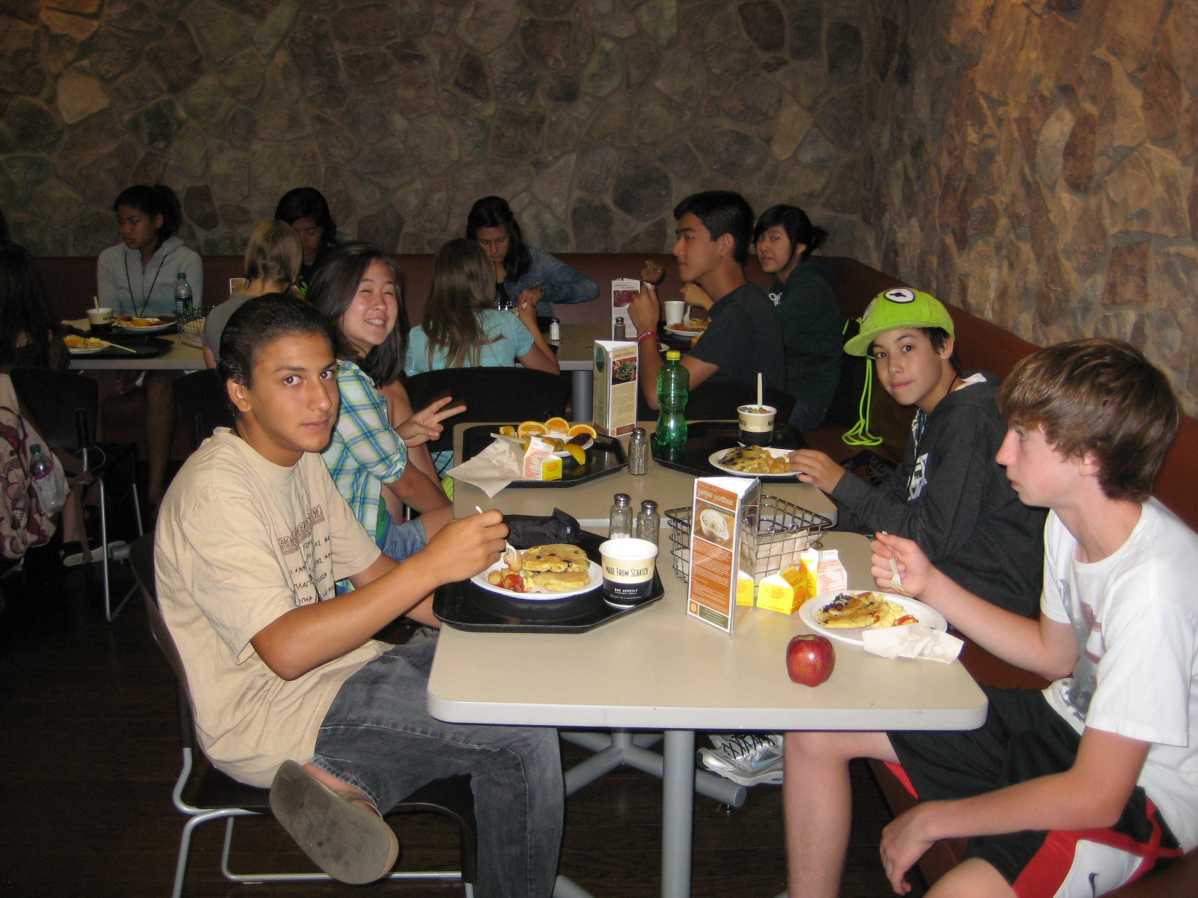

Slide 34
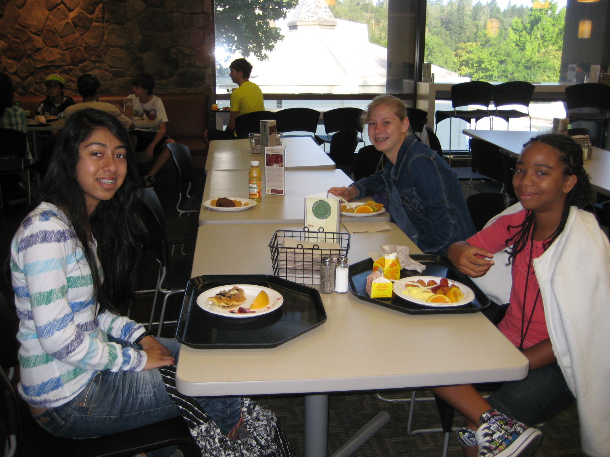

Slide 35
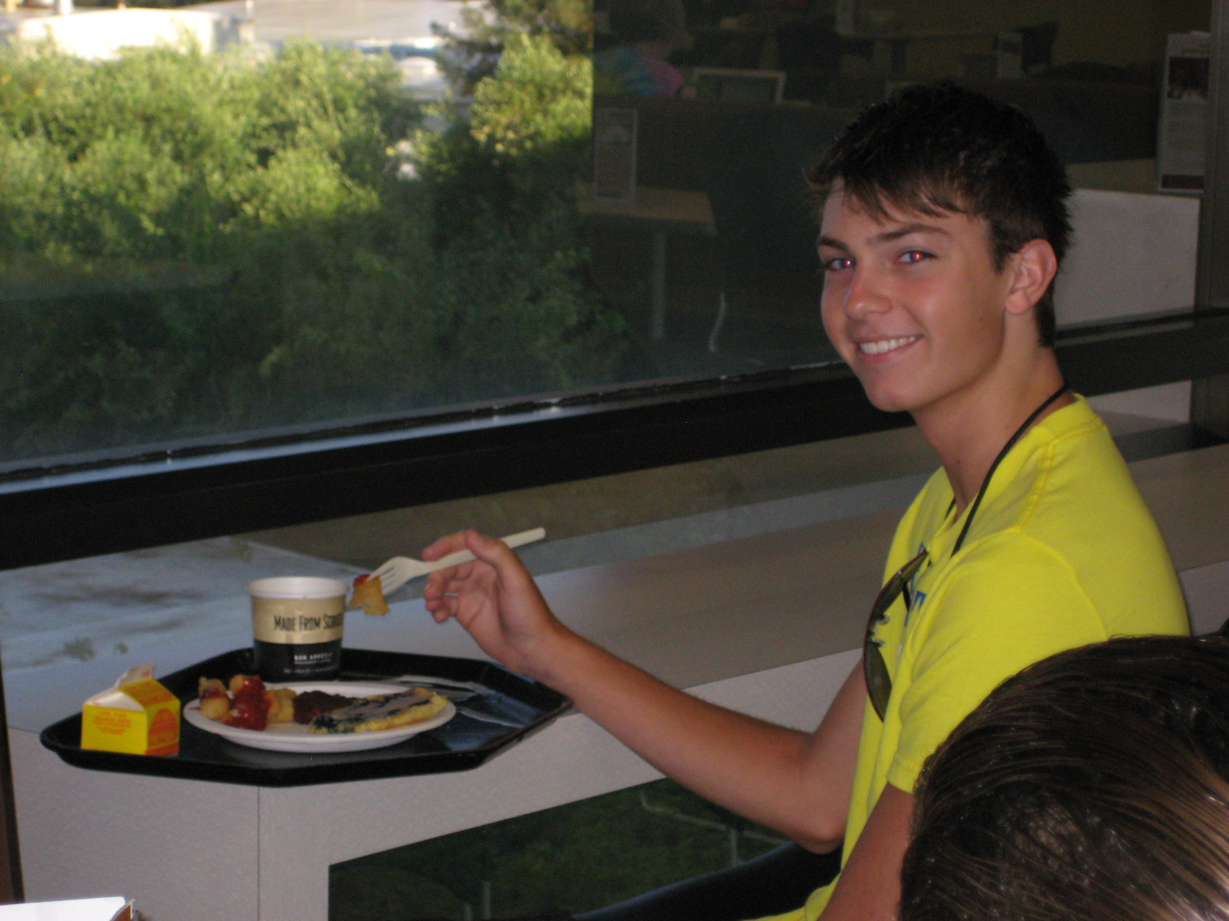

Slide 36
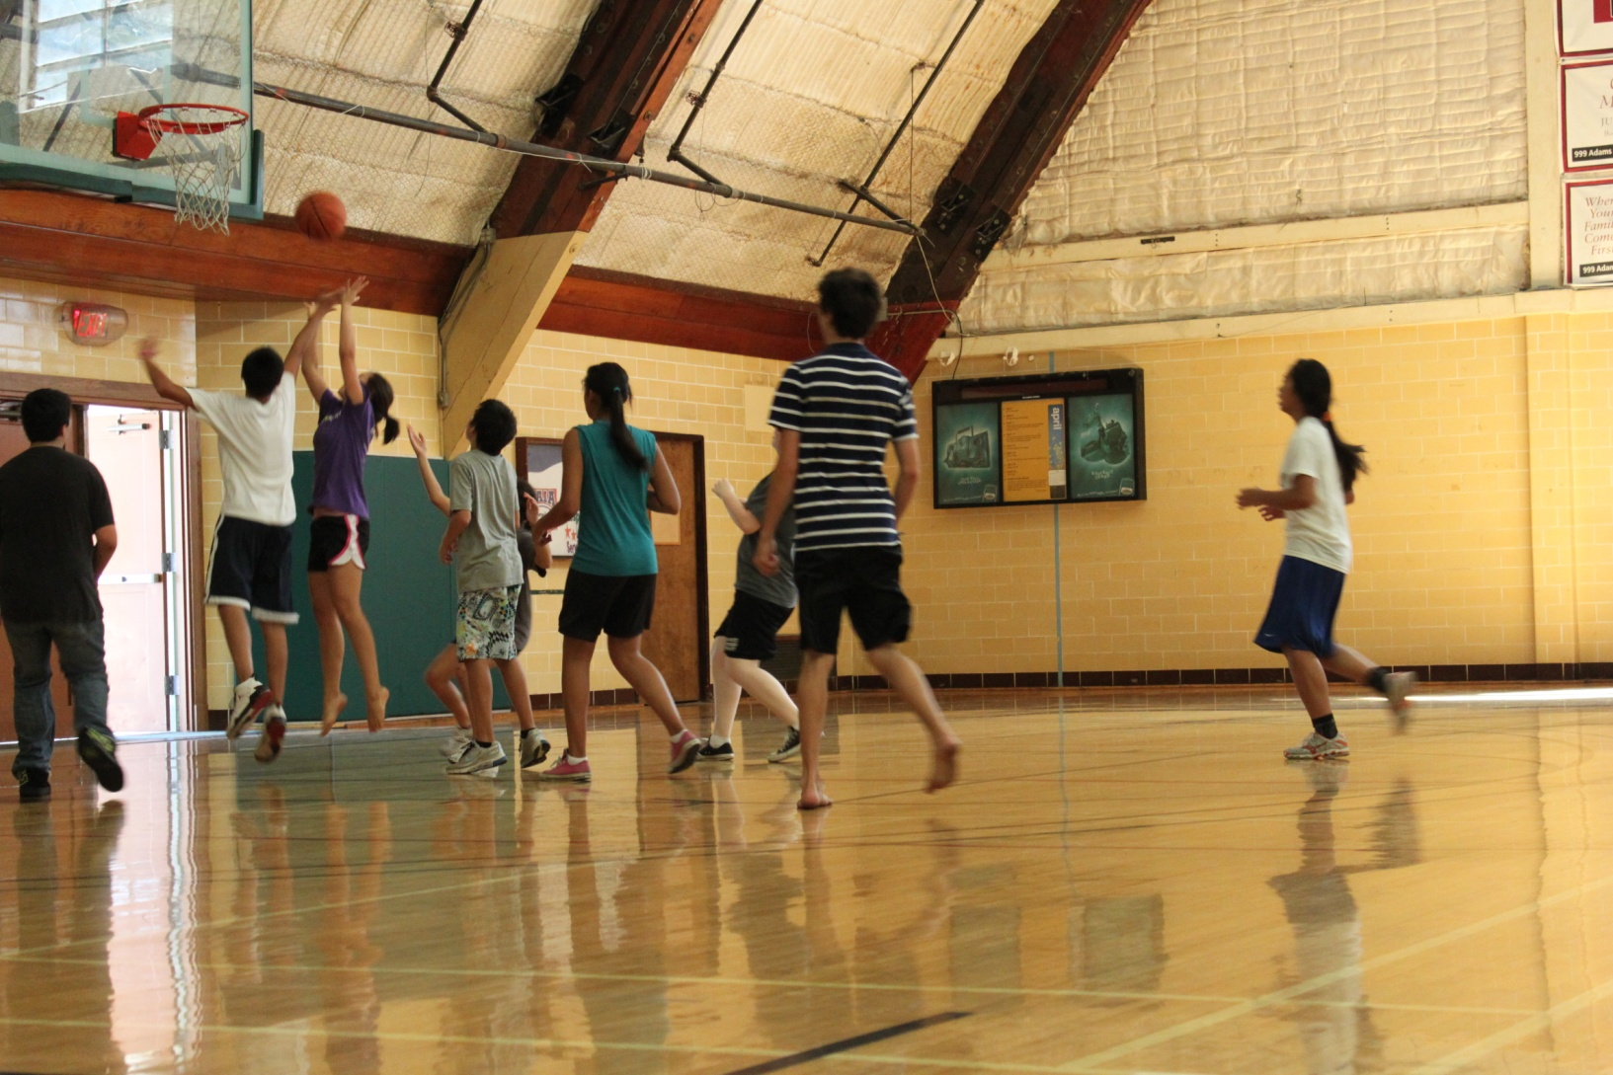
Rec Activity

Slide 37
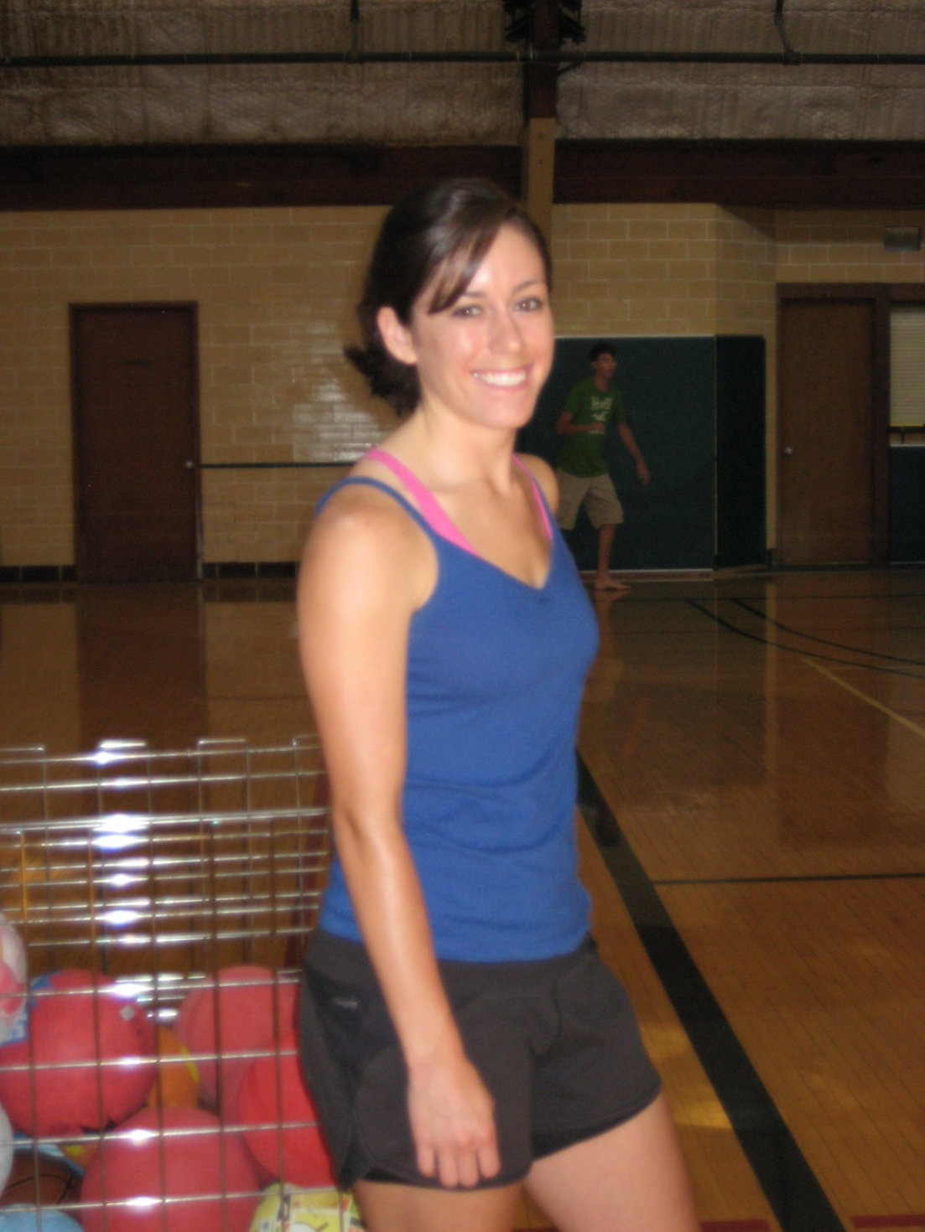
Coach Carla

Slide 38
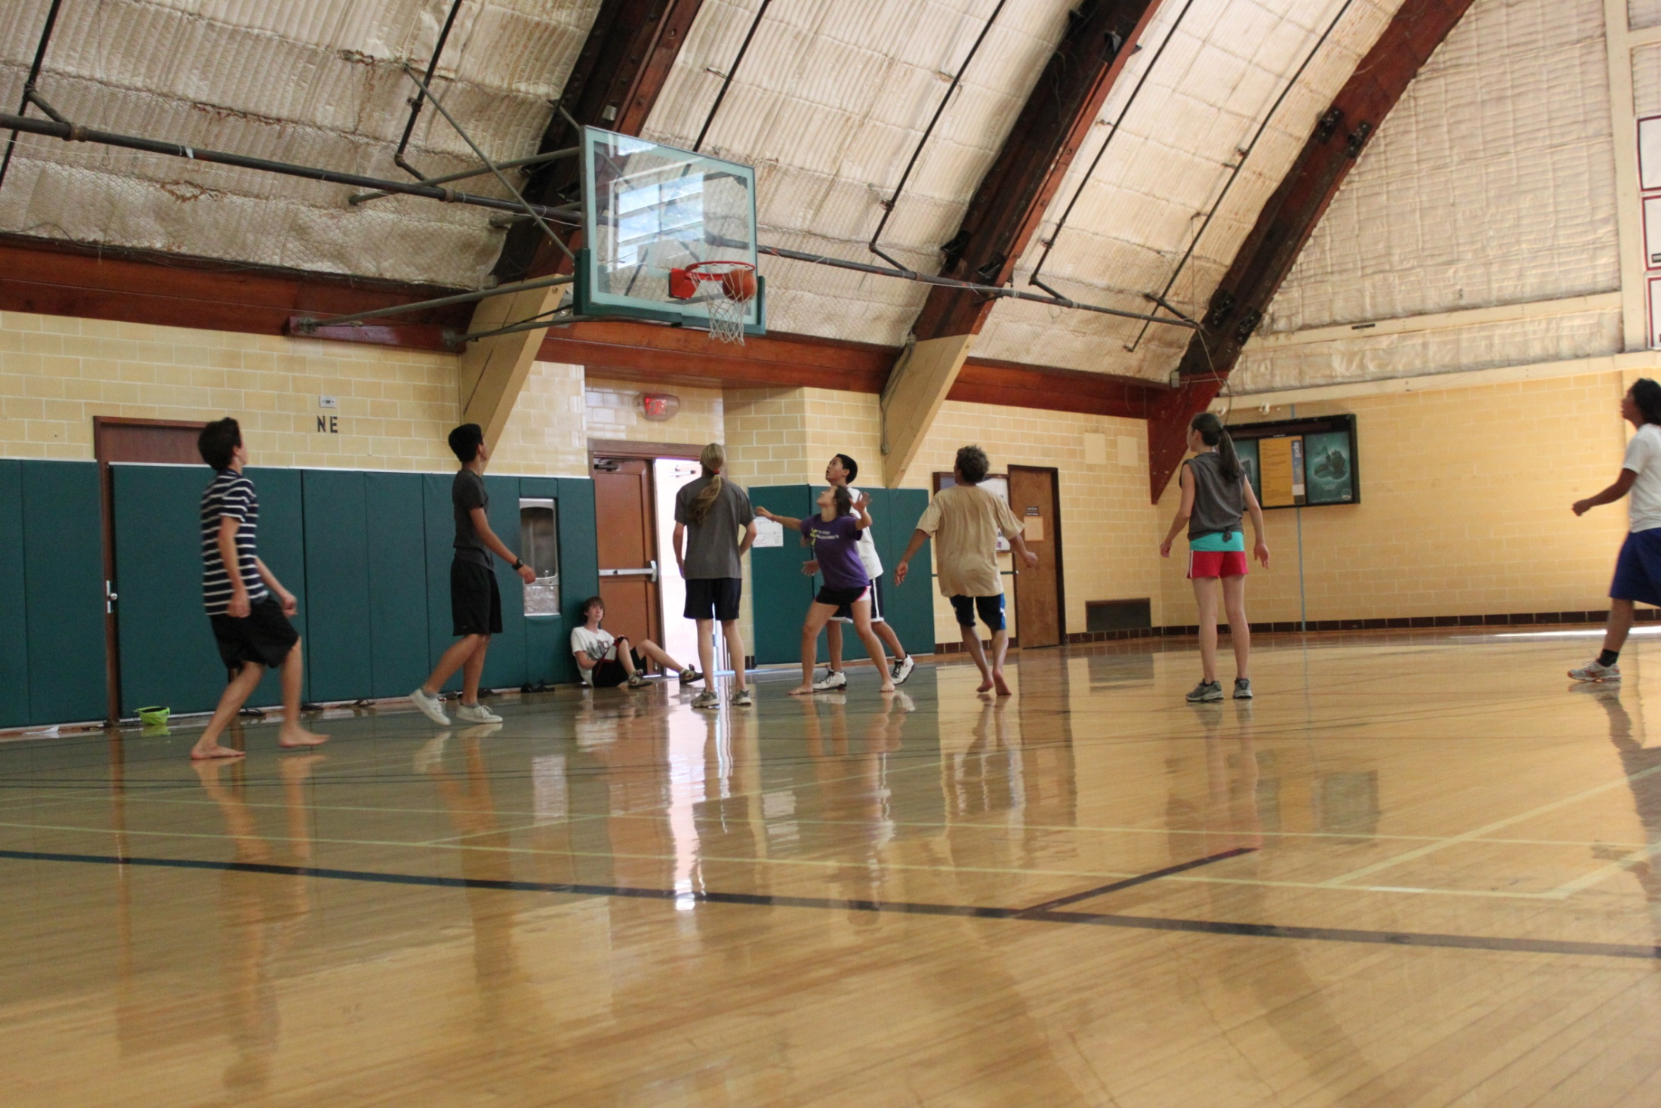

Slide 39
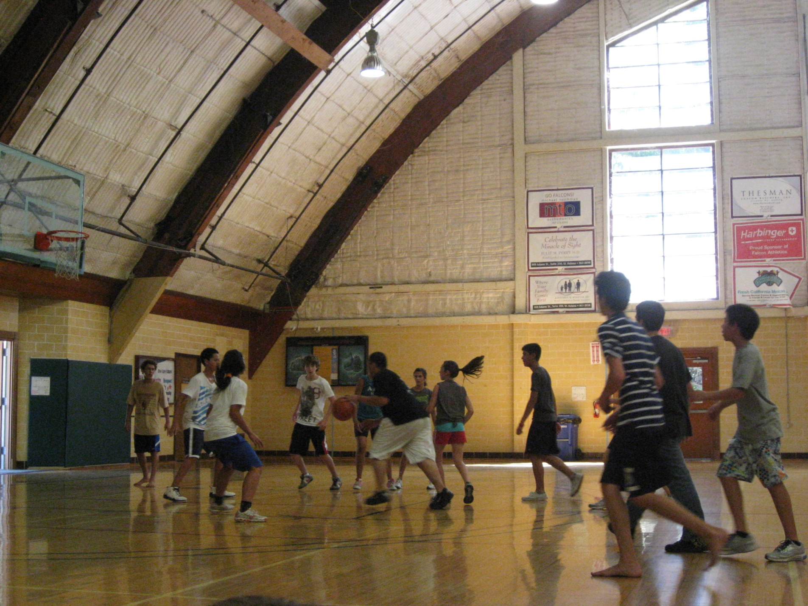

Slide 40
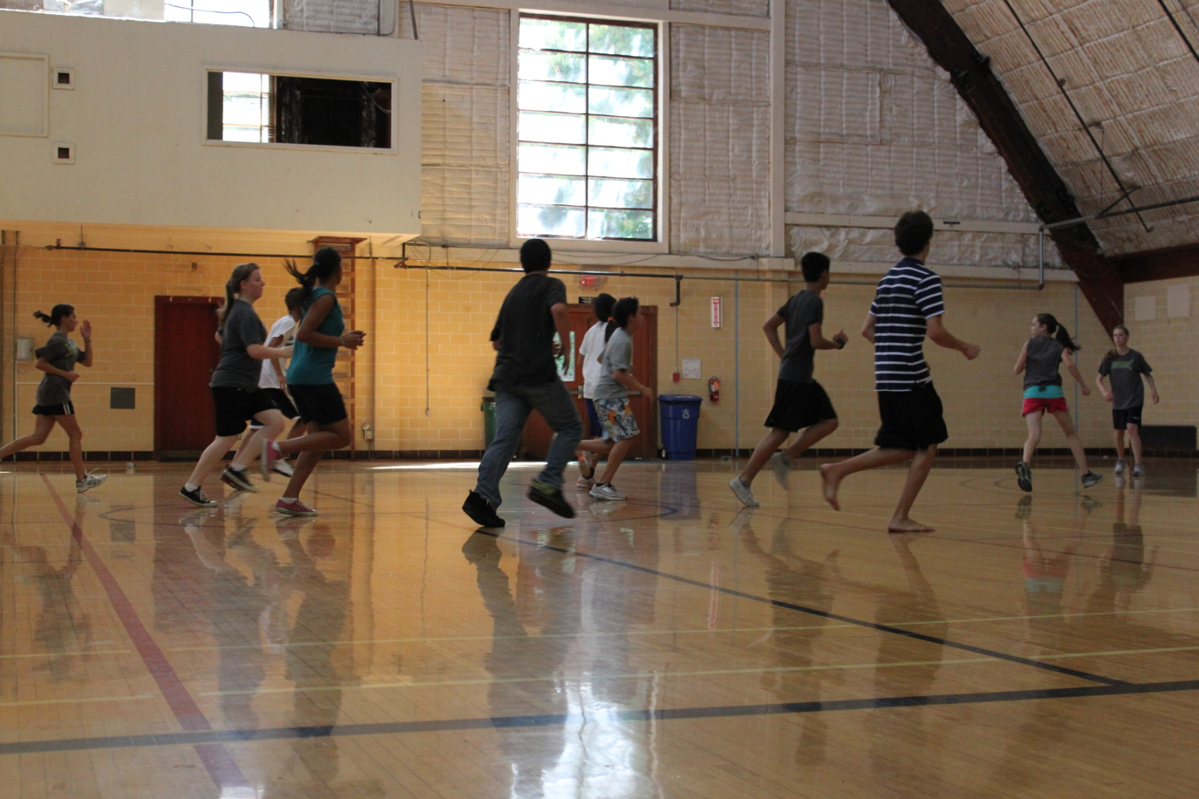

Slide 41
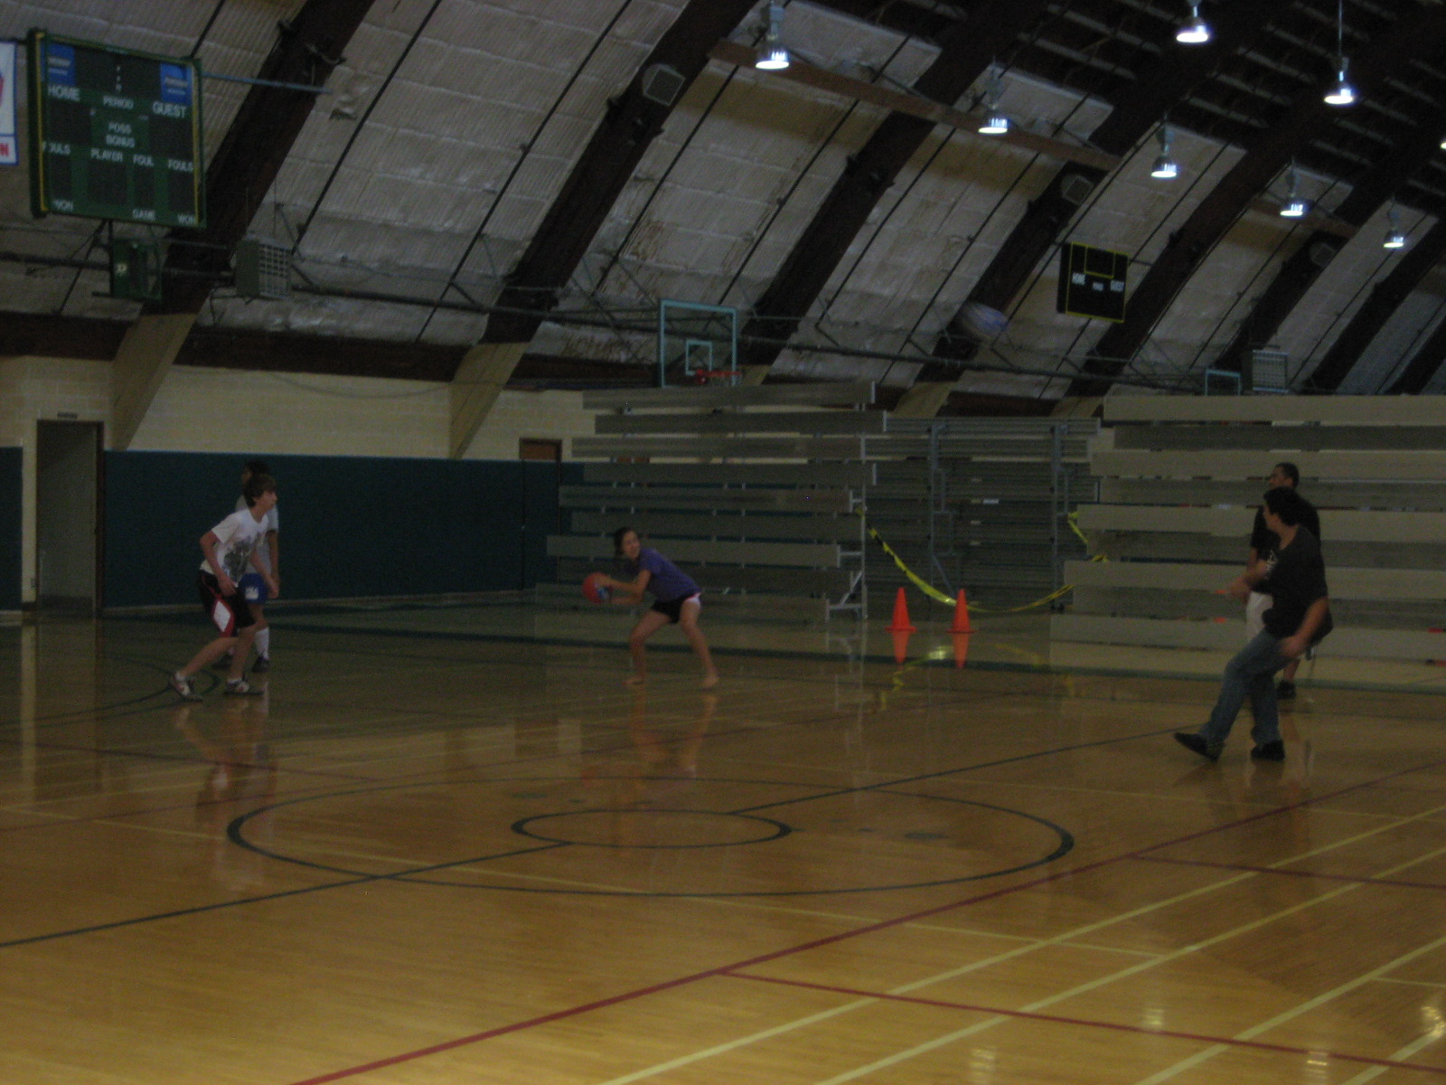

Slide 42
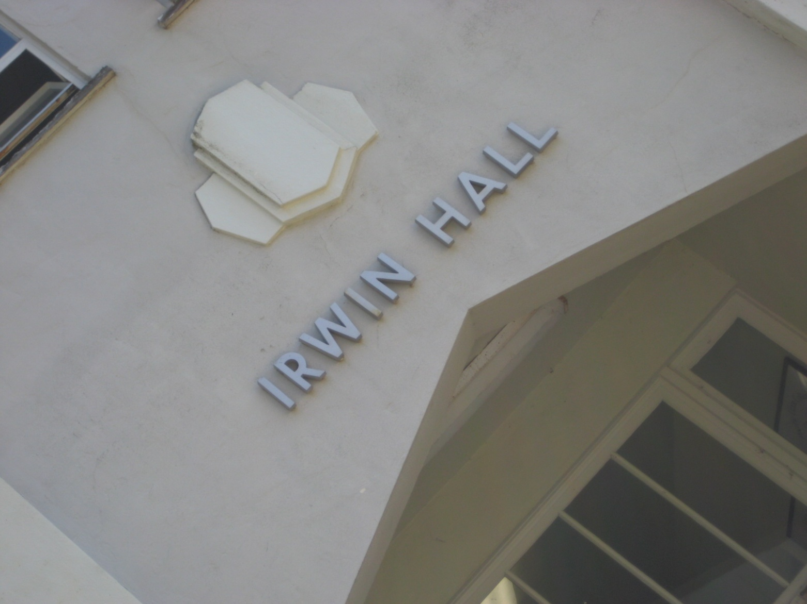
Computer Lab

Slide 43


Slide 44


Slide 45


Slide 46
Free Time

Slide 47


Slide 48


Slide 49


Slide 50


Slide 51
Evening Programs

Slide 52

Mr. Isiais Jacobo

Slide 53



Slide 54


Slide 55


Slide 56


Slide 57



Slide 58



Slide 59

Mr. Tom Amato

Slide 60

Quiz Bowl

Slide 61


Talent Show

Slide 62


Slide 63


Slide 64


Slide 65


Slide 66

Pool Party

Slide 67


Slide 68



Slide 69


Slide 70



Slide 71

Andrea’s feet!

Slide 72

PQ Staff

Slide 73


The Counselors

Slide 74


Alba

Slide 75


Jose

Slide 76

Doug

Slide 77

PQ! … Family!

Slide 78


Slide 79


Slide 80


Slide 81


Slide 82


Slide 83


Slide 84


Slide 85


Slide 86


Slide 87


Slide 88


Slide 89



Slide 90


Slide 91


Slide 92


Slide 93


Slide 94


Slide 95











3 Year PQ Alums
The way they were…

Slide 96










3 Year PQ Alums
PQ 2010

Slide 97










3 Year PQ Alums
PQ 2009

Slide 98
PacificQuest 2011

